Slide 1
Plan Drivers (Draft)
April 16, 2021

Slide 2
What are “Plan Drivers”?
Conditions, events, trends, and movements that are driving change in Ventura
Can be positive, negative or neutral
Can include both current and anticipated issues
Cost of living (current)
Sea level rise (anticipated)
Address multiple, interrelated General Plan topics
Developed based on community input and findings from existing conditions analysis

Slide 3
Population and Demographics

Slide 4
Population Shifts
Age Group | % Change (2000-2019)
Under 5 | -1.2%
5-19 | -4.8%
20-34 | 2.9%
35-54 | -8.9%
55-64 | 6.4%
65-84 | 4.8%
85 and Over | 0.7%
Source: American Community Survey, 2019
Aging population: Share of residents aged 65+ increased from 2000 to 2019
Fewer families with children: Residents 19 and under declined by 6%
Growing cultural diversity: Latinx population increased by 19.7 percent and White population decreased by 21.3 percent from 2000 to 2019
Race/Ethnicity | % Change (2000-2019)
White/Caucasian | -21.3%
Hispanic/Latinx | +19.7%
Source: American Community Survey, 2019

Slide 5
Land Use and Housing

Slide 6
RHNA Requirements
Jurisdictions must plan for the RHNA. Adequate sites with:
Appropriate density and development standards (at least 30 du/ac for lower income RHNA for Ventura)
Vacant and underutilized sites with near-term development potential
Development process and fees do not constrain housing development
 | Ventura City |  | County
Income Group | RHNA | Percent | RHNA | Percent
Very Low Income (50% AMI) | 1,184 | 22.4% | 5,759 | 23.6%
Low Income (80% AMI) | 863 | 16.2% | 3,803 | 15.6%
Moderate Income (120% AMI) | 948 | 17.9% | 4,516 | 18.5%
Above Moderate Income (>120% AMI) | 2,305 | 43.5% | 10,318 | 42.3%
Total | 5,300 | 100.0% | 24,396 | 100.0%

Slide 7
Cost of Housing
Median home sales price ($583,000) is considered unaffordable for a moderate income four-person household
Median rental costs have increased roughly 18 percent since 2015
Lower income households spend a greater share of income on housing than other groups
60+ percent of households earning less than $35,000 are severely rent burdened
98 percent of mortgage holders earning less than $35,000 are cost burdened
 | Dec. 2015 | Dec. 2020 | % Change
Studio | N/A | $1,525 | -
1-Bedroom | $1,527 | $1,865 | 22.1%
2-Bedroom | $1,874 | $2,431 | 29.7%
3-Bedroom | $2,312 | $3,149 | 36.2%
4-Bedroom | $2,695 | $3,425 | 27.1%
Median Rent | $2,102 | $2,479 | 17.9%
Source: Zumper.com, January 2021

Slide 8
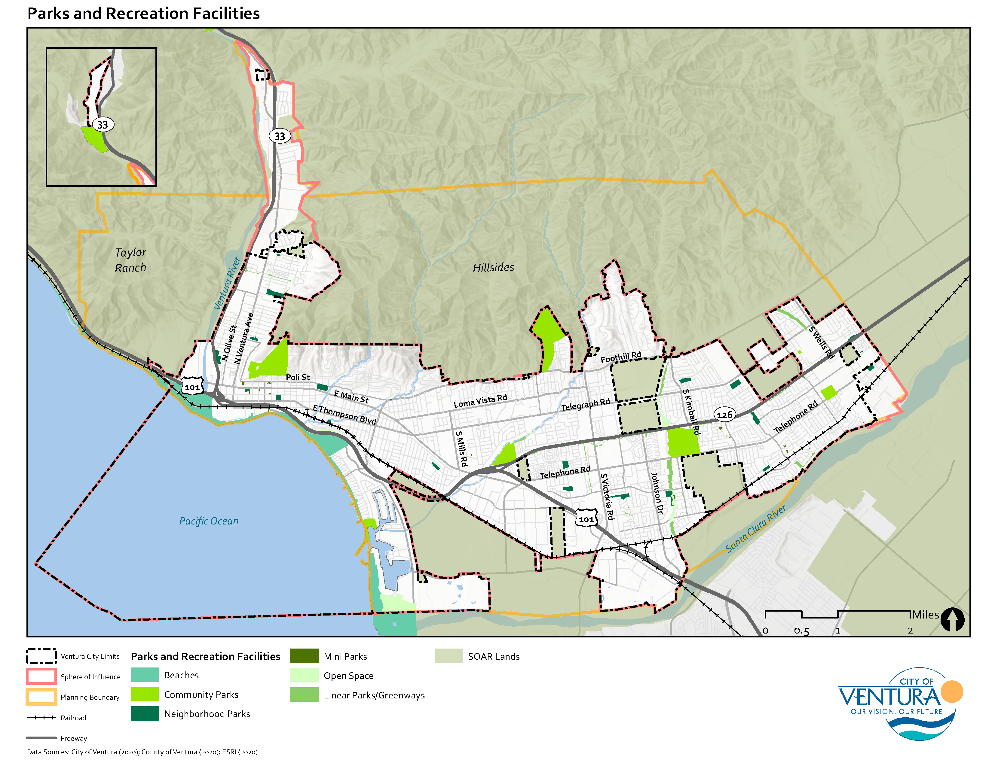
Protection of Open Space and Natural Areas
Open space and natural areas are treasured by the community
81.2 percent of survey respondents deemed “access to nature” a special asset that they want to preserve
SOAR Initiatives protect open space, limiting potential for expansion beyond the existing City Limits
Future growth will likely occur in existing infill areas

Slide 9
Economic Development

Slide 10
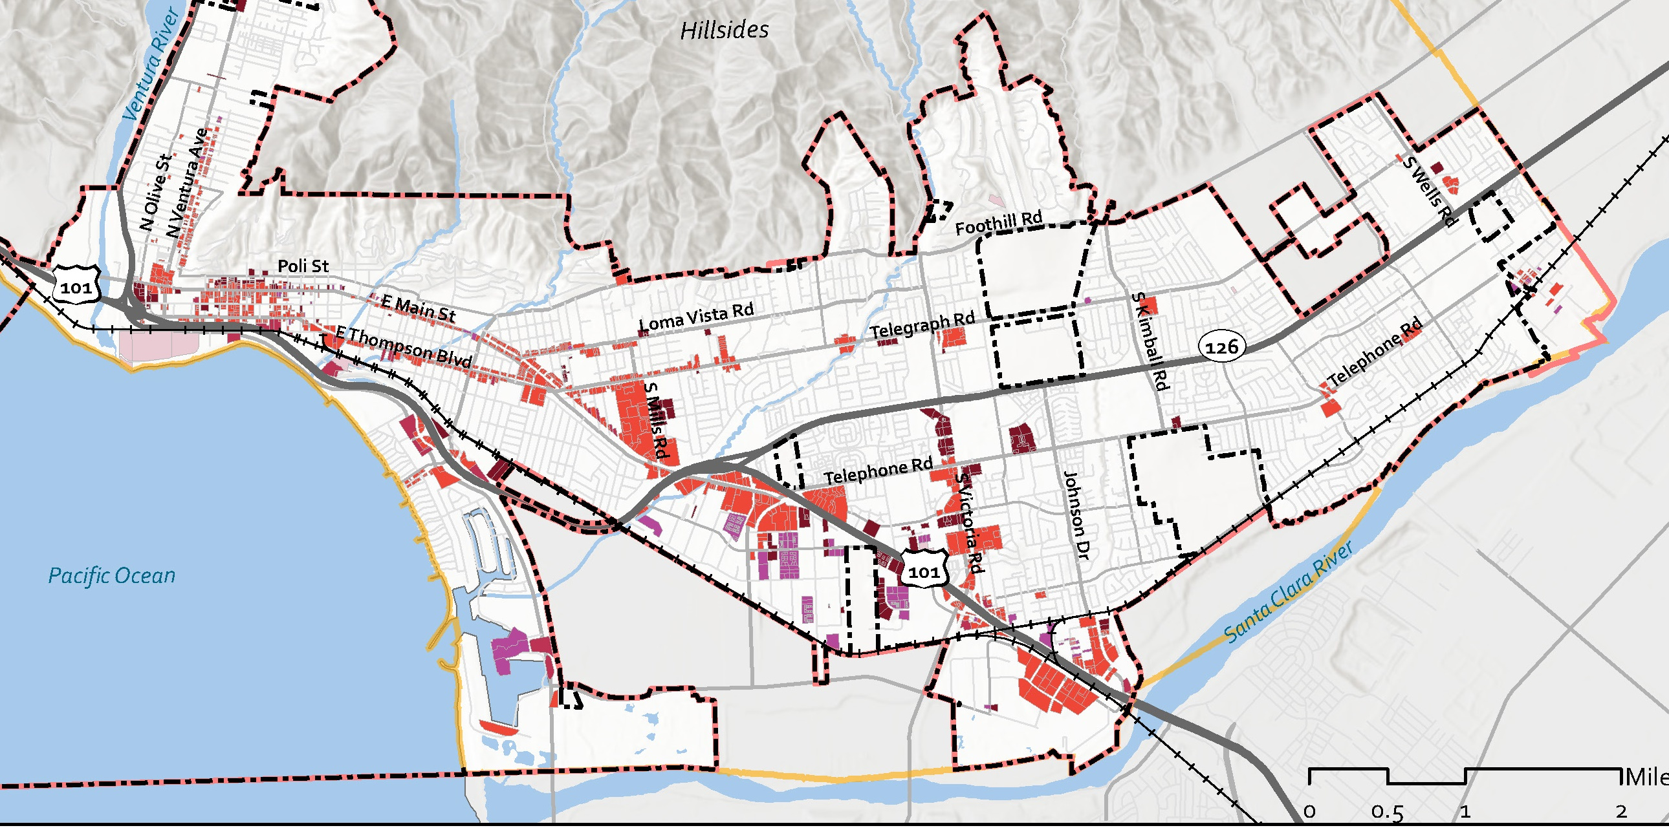
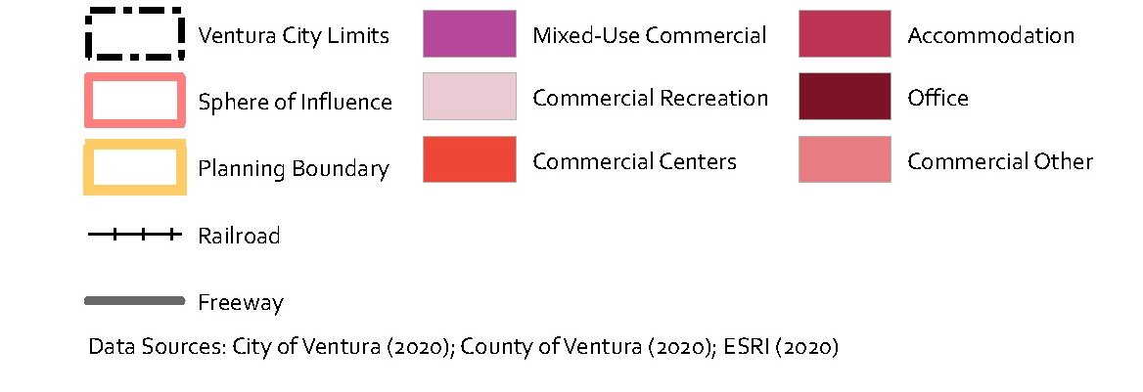
Changing Retail Environment
E-Commerce makes brick-and-mortar retail increasingly unviable
High turnover, vacant properties, etc.
COVID-19 has negatively impacted retail sales
Vacant and underutilized sites could be redeveloped as different uses

Slide 11
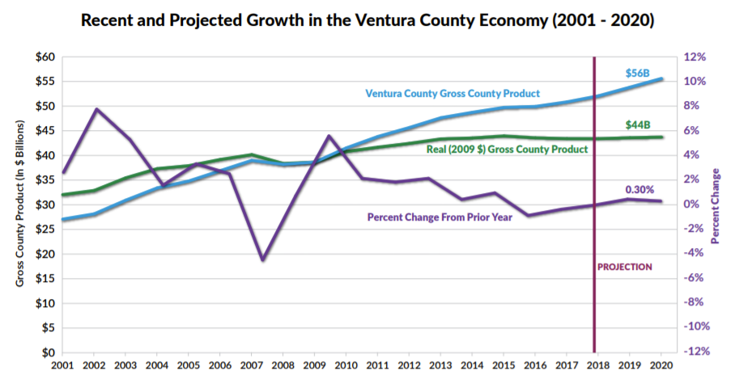
Stagnant Regional Economy
Ventura County is “high-cost, low-growth”
2013-2018: County experienced almost no economic growth (adjusted for inflation)
As of 2019, annual employment growth has not topped 1.5 percent since 2013
Job growth is generally concentrated in lower-wage sectors
2000-2017: Service jobs grew 7.1 percent while goods-producing jobs fell 14.1 percent
Source: Ventura County Civic Alliance, 2019

Slide 12
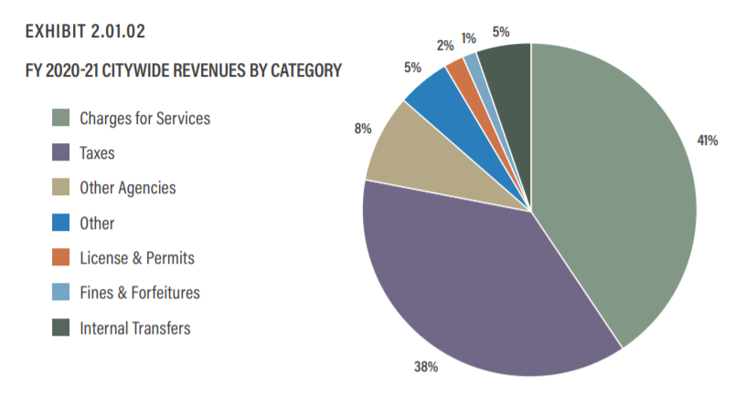
Fiscal Stability and Public Services
City budget for FY2020-21 is 3.5 percent lower than the previous fiscal year
City projected a structural deficit of $4.1 million even before the pandemic (Jan. 2020)
Services fees (41 percent) and taxes (38 percent) comprise most of City revenue
Property and sales taxes split almost equally
Costs of services will continue to increase
Land use and other policy decisions impact City revenues
Source: City of Ventura, 2020

Slide 13
Mobility

Slide 14
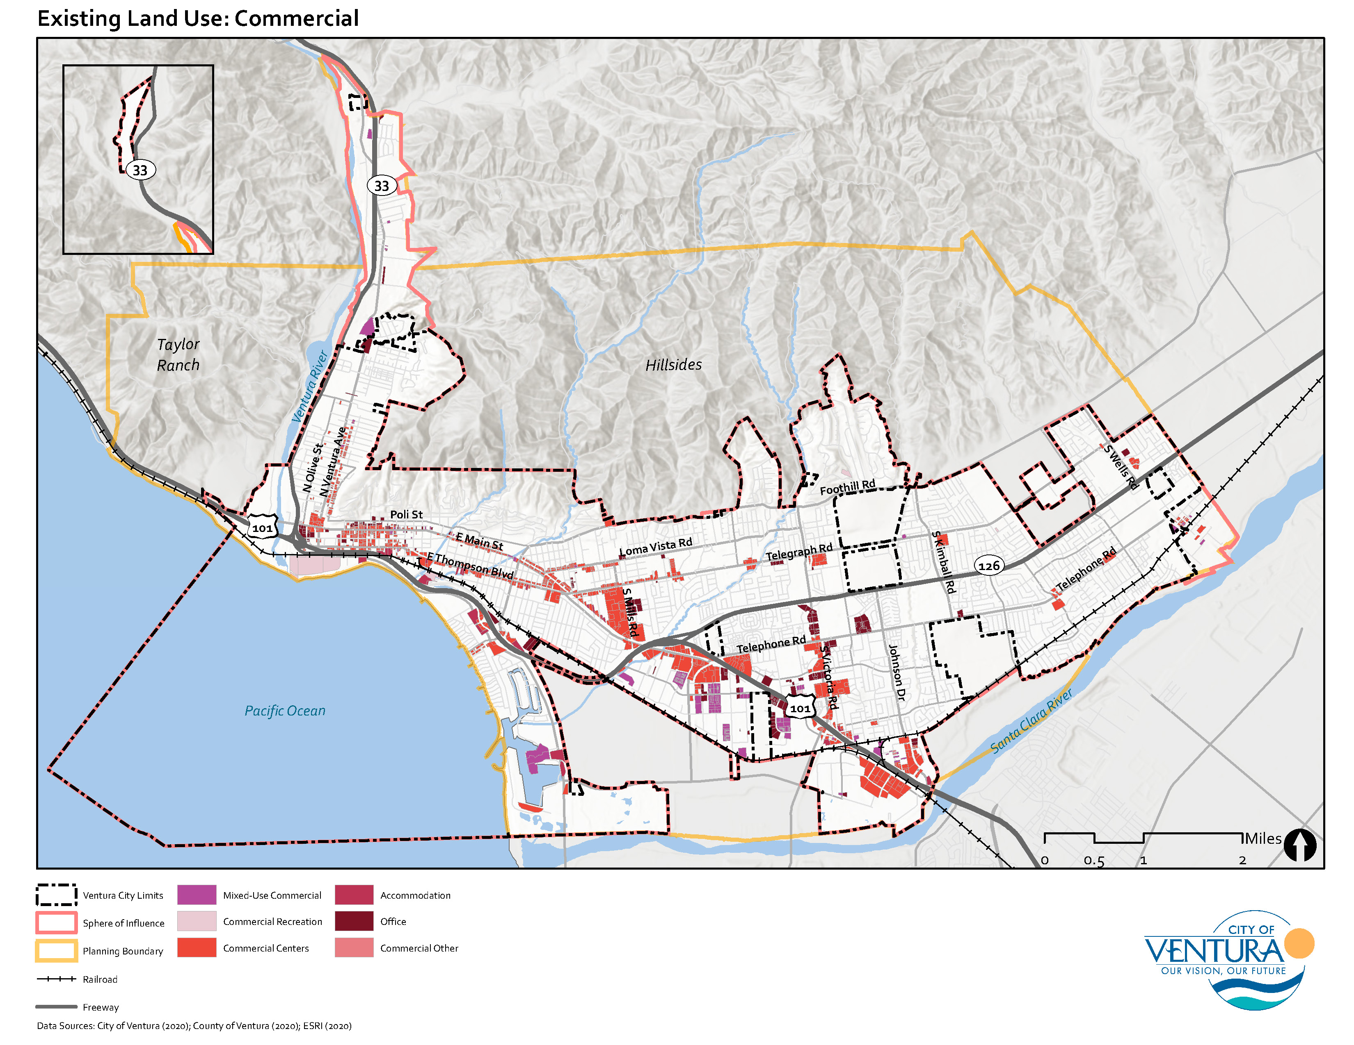
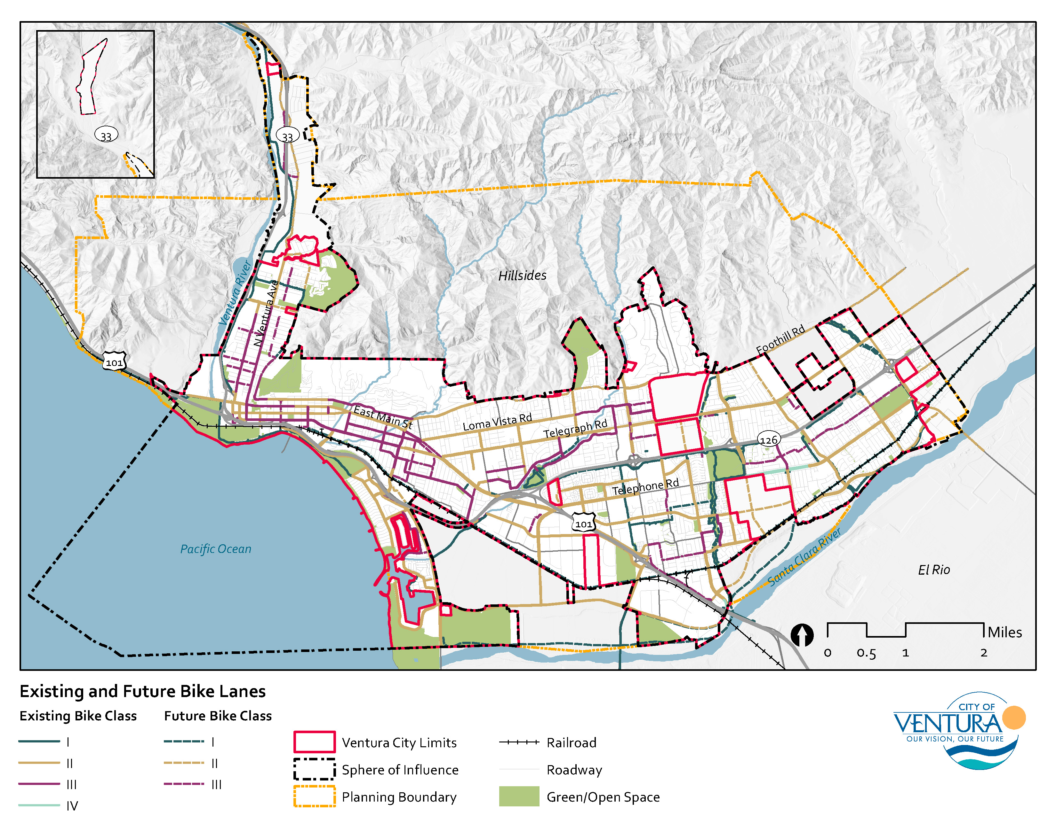
Focus on Active Transportation
Active transportation is important for Ventura residents More than a third of survey respondents (34.4 percent) believe “improving walking and biking” is a key issue to address
Increased emphasis (nationally) on activate transportation to promoting healthy lifestyles and reduce GHG emissions
City undertaking Active Transportation Plan in parallel with the General Plan

Slide 15
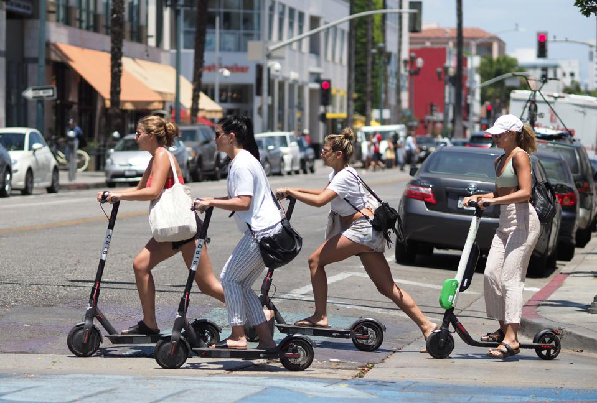
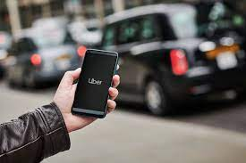
New Mobility
Shared mobility is changing how we move around the city
Ride-share (Uber, Lyft, vanpool programs)
Micromobility (Bike-share, scooter-share)
Transportation innovations can have economic ramifications
Micromobility can stimulate local sales
Autonomous vehicles may ultimately replace driving jobs (e.g., delivery services)
Notes:
https://www.emorybusiness.com/2021/03/11/research-reveals-shared-e-scooter-systems-can-generate-significant-positive-economic-spillover/

Slide 16
Health and Equity

Slide 17
Equity
Increasing awareness of structural inequities and racism
In Ventura County, Black and Hispanic/Latinx people are disproportionately arrested
Greater awareness of local government’s role in promoting equity and justice through planning and decision-making
Source: California Department of Justice, 2019; American Community Survey, 2019

Slide 18
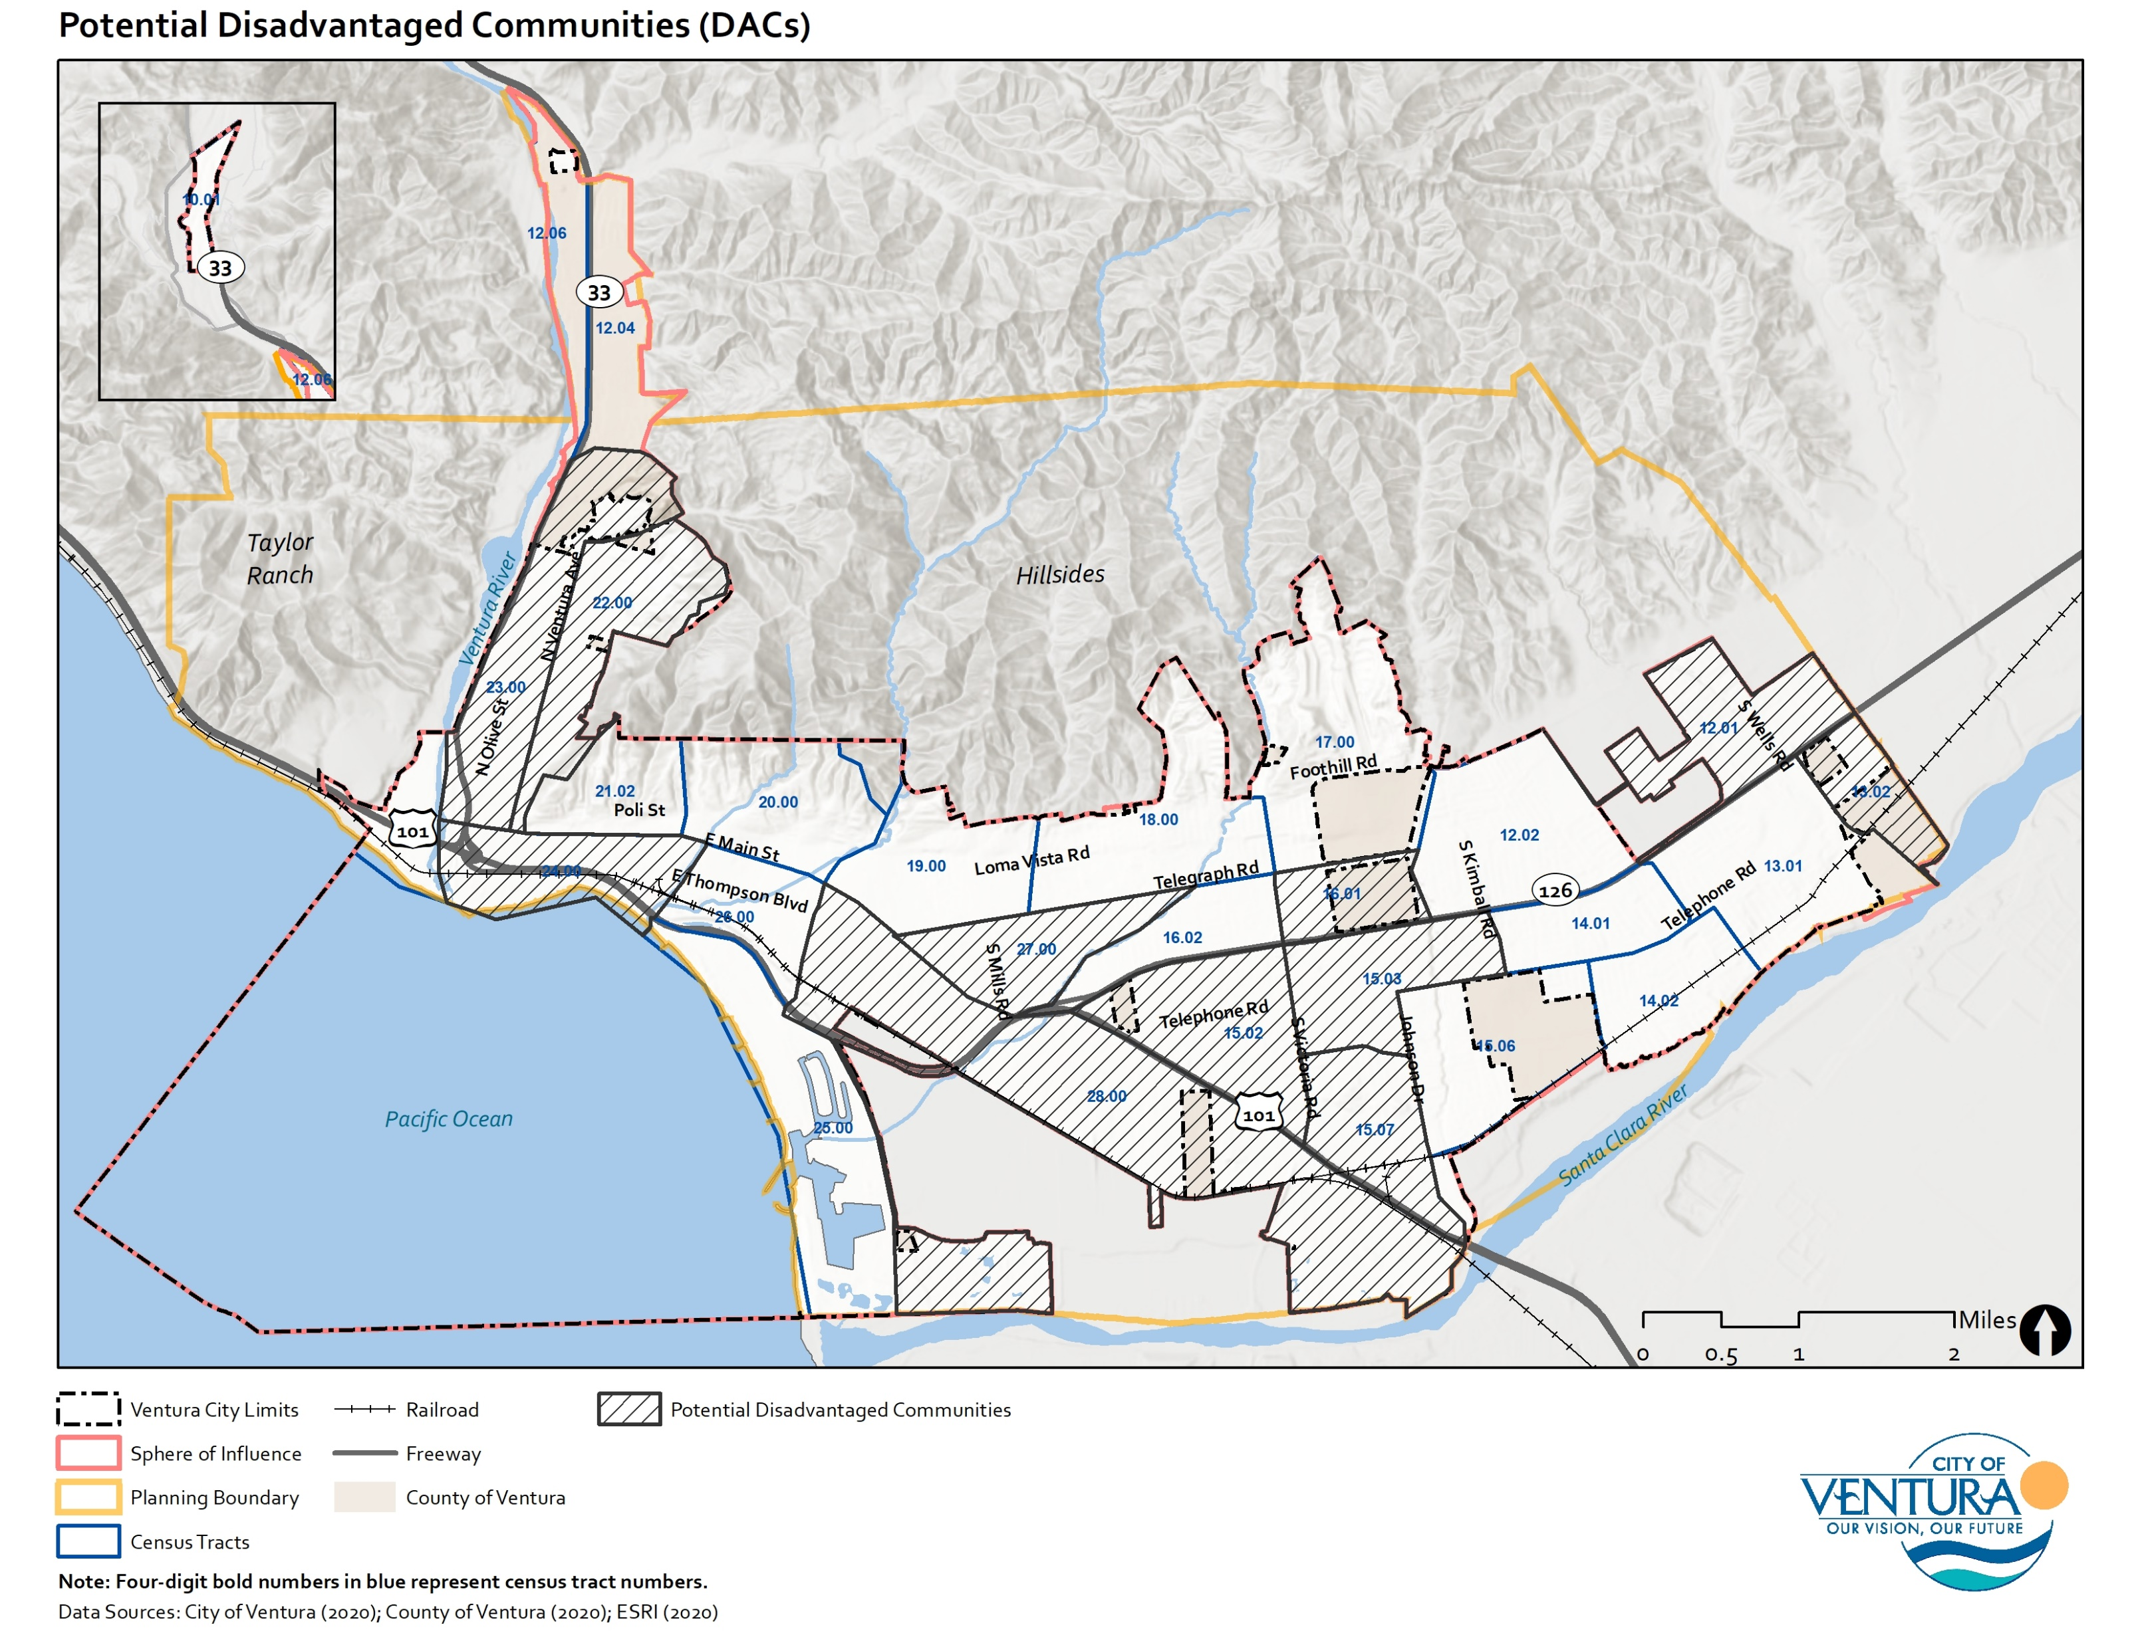
Environmental Justice
New state law – SB 1000 requires focus on “environmental justice” and identification of “disadvantaged communities”
Addresses intersection between lower income communities, pollution burden and health disparities
Pollution exposure
Public facilities
Safe and sanitary homes
Physical activity
Other identified health risks or burdens

Slide 19
Public Facilities and Services

Slide 20
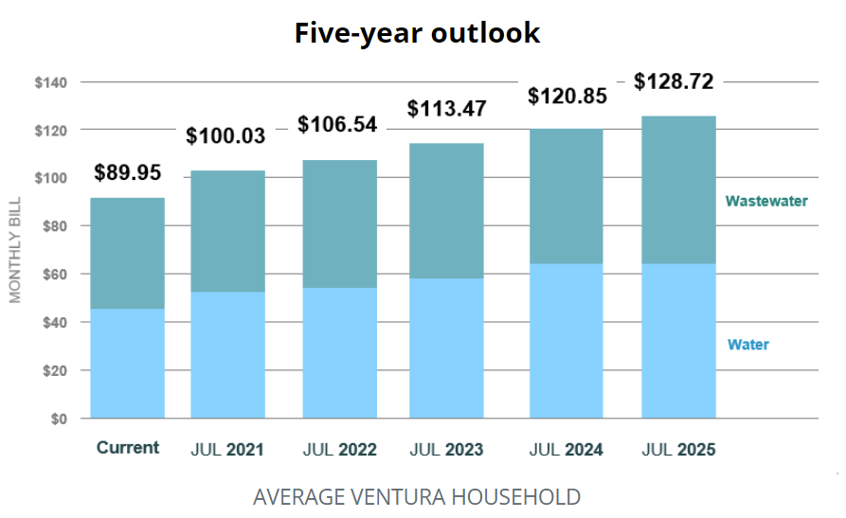
Water Supply
City studies show tight water supply in coming years
Drought risk will increase as climate change intensifies, further constraining water supply
Revised water rates will create revenue to support needed improvements
 | 2020 | 2021 | 2022
Supply | 15,744 | 17,408 | 16,510
Demand | 15,789 | 15,974 | 16,158
Surplus/Deficit | 45 | 1,434 | 352
Source: City of Ventura, 2021
Source: City of Ventura, 2020

Slide 21
Climate Change and Environment

Slide 22
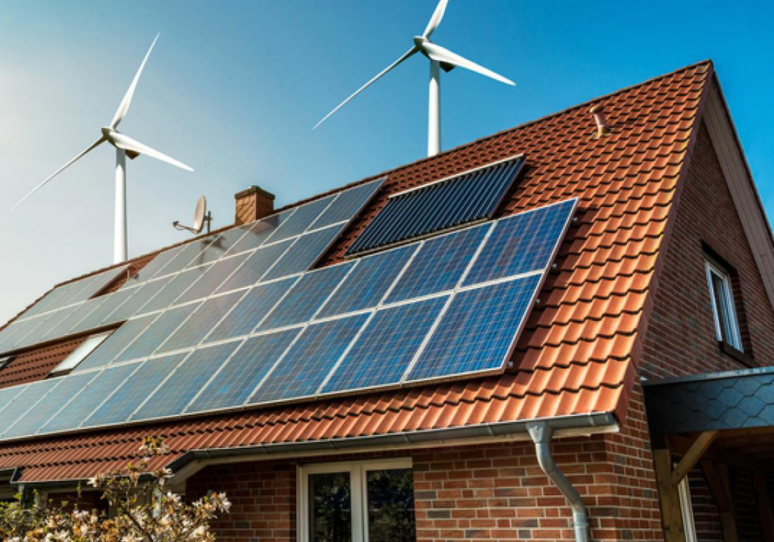
Carbon Neutrality
California requirements:
Zero net energy buildings by 2030
Carbon neutrality by 2045
State requirements will influence land use decisions, transportation planning, and infrastructure decisions

Slide 23
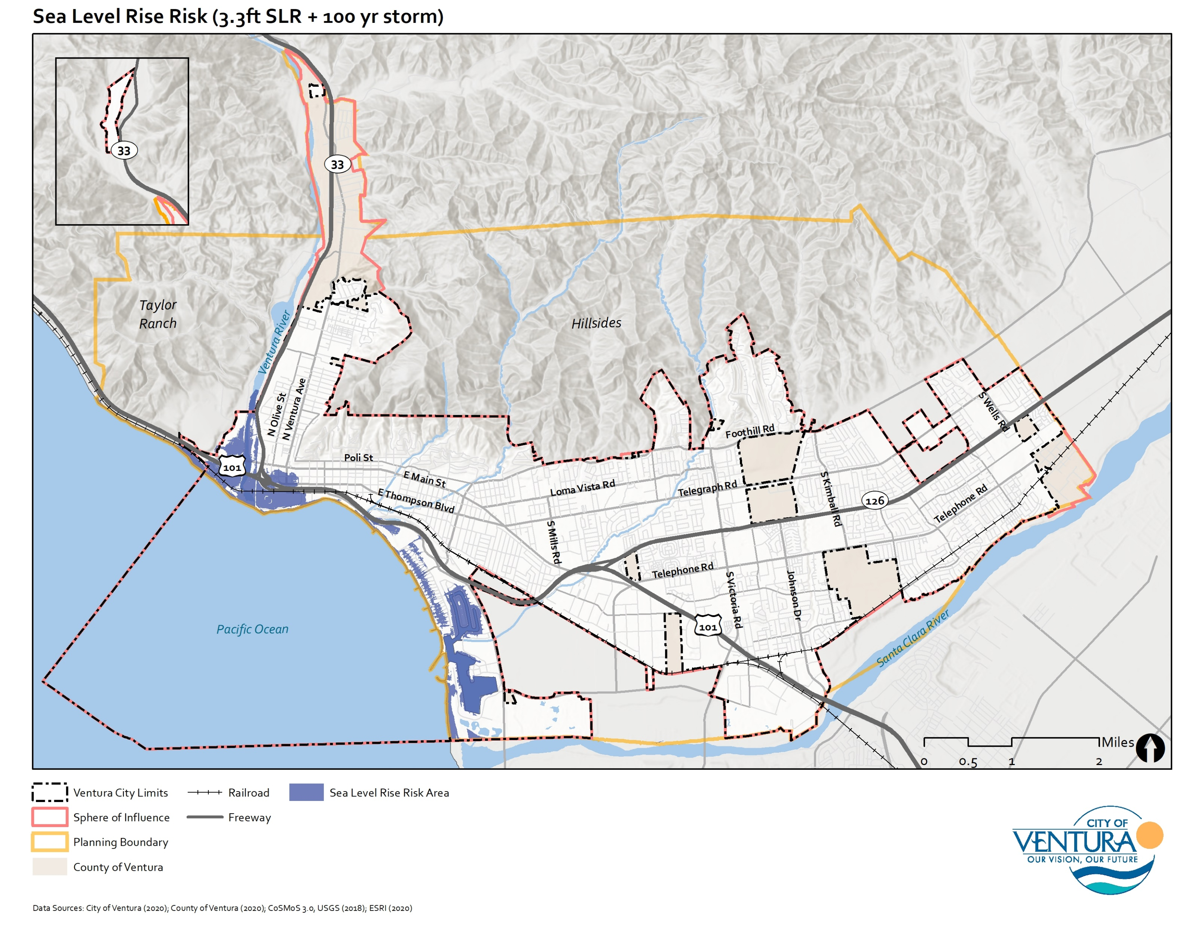
Climate Change
Sea level rise threatens coastal areas like Pierpont, Marina, and Downtown
Southern California could experience 3+ feet of sea level rise by 2100 (State of California Sea Level Rise Guidance, 2018)
Need to develop resilience strategies, including updated land use and building regulations
Extreme heat events may increase in frequency, requiring emergency planning for vulnerable populations

Slide 24
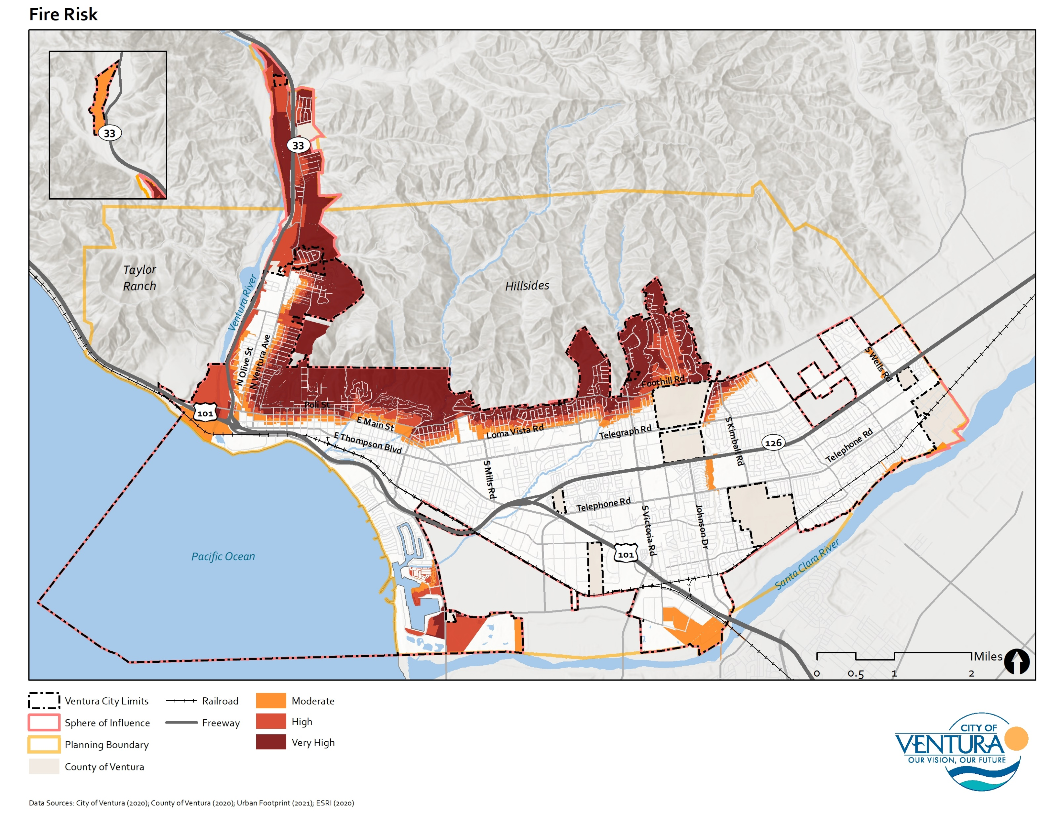
Wildfire Hazards
Increasing severity and prevalence of wildfires as climate change intensifies
Westside, Downtown, Midtown, and foothill areas all at high risk
Concern over evacuation routes and water supply in emergencies
Need to develop additional resilience strategies
Fire risk could also influence settlement patterns

Slide 25
Other

Slide 26
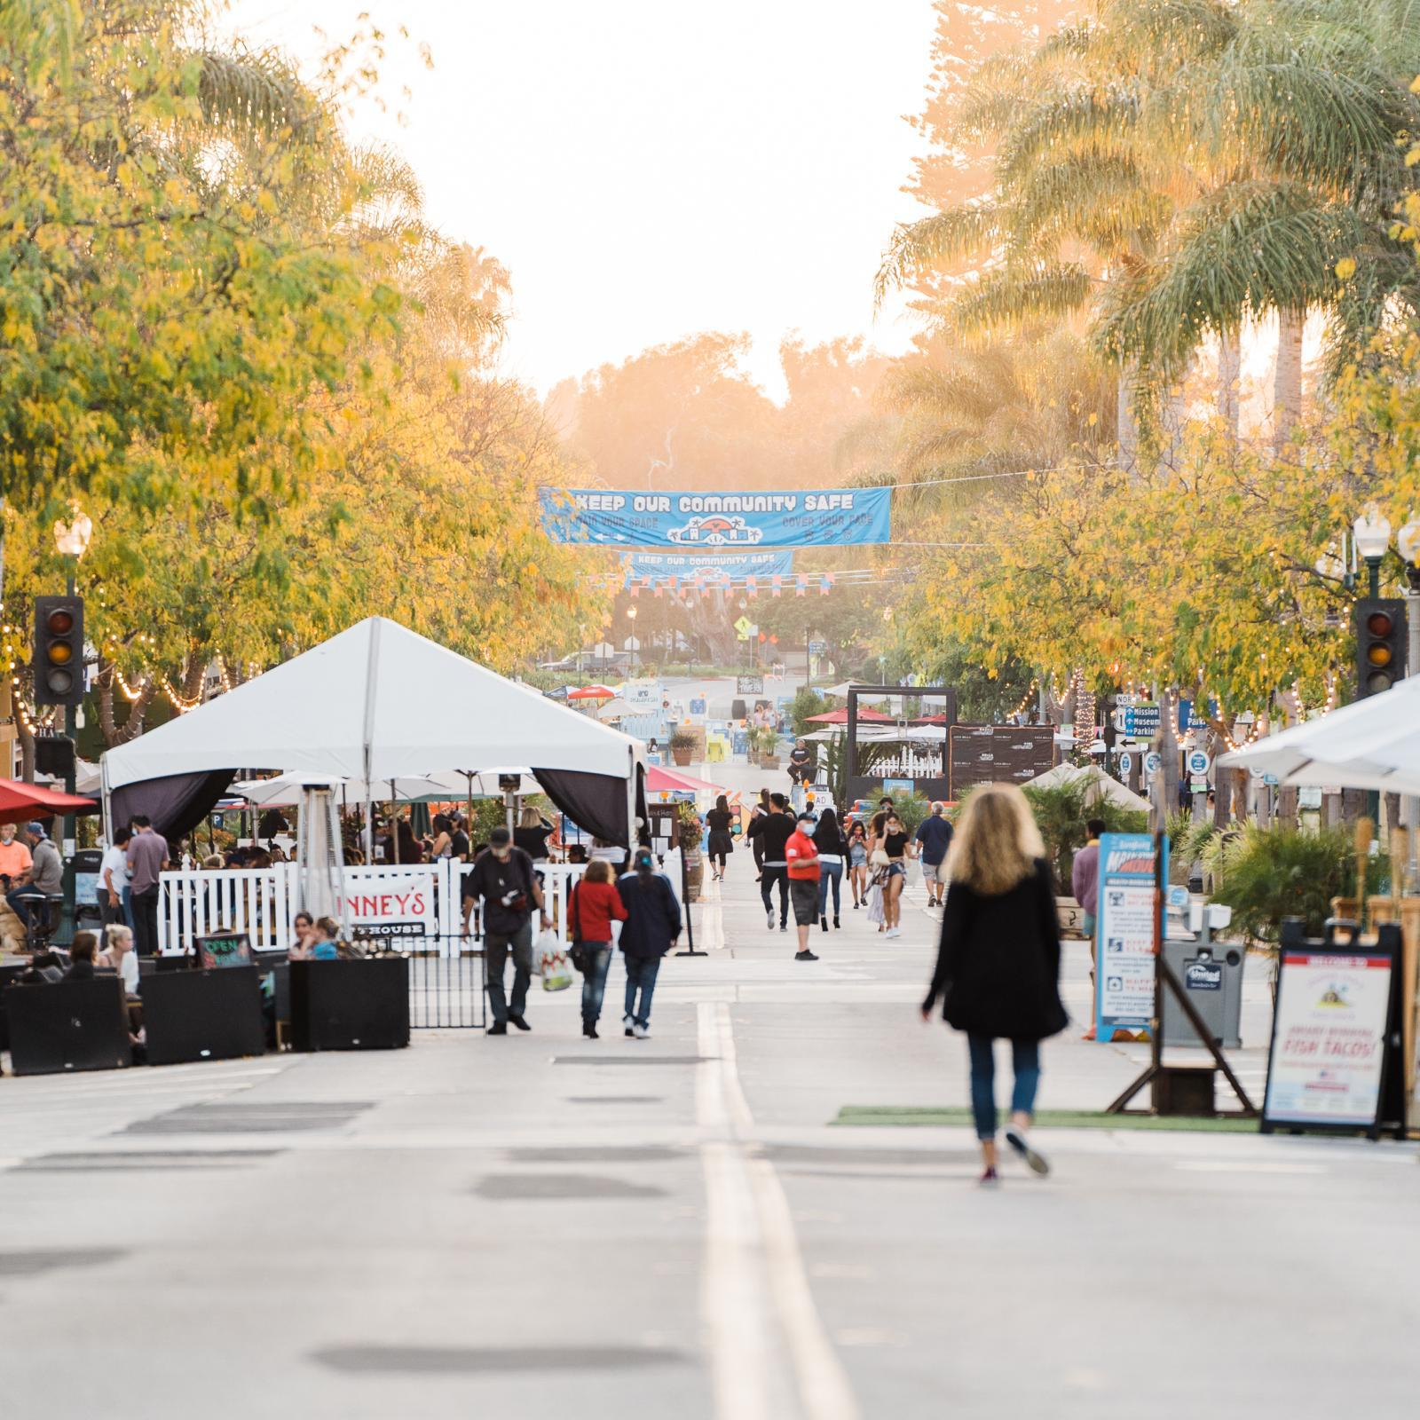
COVID-19 Recovery
Future revenue shortfalls
Low sales and transient occupancy taxes may increase budget deficit
Recovery and aid for small businesses
Greater appreciation for outdoor dining and slow streets
Impact of telecommuting on land use decisions and settlement patterns

Slide 27
Creative Economy
Economic activities where value is based on “imaginative qualities”
Arts, food, entertainment, architecture, media, etc.
Ventura’s creative economy is above-average nationally
4,408 “creative jobs” (2019)
$188 million in industry revenue (2019)
Strong presence of individual artists shows high growth potential in the creative sector

Slide 28
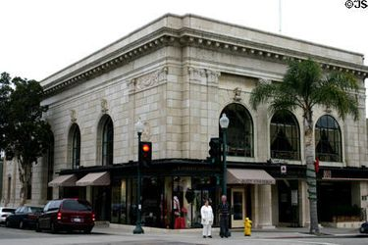
Historic and Cultural Resources
Community desires for historic preservation shaping contours of growth
Nearly one-fifth of survey respondents (19.5 percent) deemed “historic buildings” a key asset to preserve
Large inventory of protected historic sites may limit redevelopment potential on certain properties
New development will need to occur on suitable infill sites

Slide 29
Discussion Questions
Do you think this captures the main drivers of the General Plan and the City in the future? Is anything missing?
What can the City and General Plan do, if anything, to address each of these drivers?
What strategies need to be implanted to address the “plan drivers”?

