Slide 1
Draft Land Use Designations &
Preferred Land Use Map:
City Council
Updated for October 9, 2023

Slide 2
Outcomes and Agenda
Outcome: Receive endorsement from City Council on the Draft Land Use Designations and Preferred Land Use Map.
Brief Presentation Overview
Public Comment
City Council Discussion and Direction
Areas discussed: (Westside, Pacific View Mall, Midtown)
Areas without consensus (College, Johnson)
Areas w/GPAC and PC agreement (Victoria, Pierpont)
Areas w/GPAC, PC, and Public agreement (SOAR, Eastside, Downtown, Arundell)
Any area to rediscuss

Slide 3
Background and Process

Slide 4
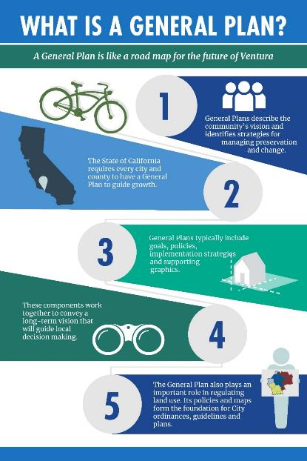
Purpose of a General Plan
Long-term policy document to guide the future actions
Enables the community to come together to develop a shared vision for the next 25-30 years
Updated every 10-15 years
Preserves and enhances community strengths
Addresses topics of concern
8 required Elements
1. Land Use
2. Circulation
3. Housing
4. Noise
5. Conservation
6. Safety
7. Open Space
8. Environmental Justice
4

Slide 5
The Family of Plans
General Plan
Sub-Area Plans
Functional Plans
Specific Plans
Community Plans
Active Transportation Plan
Climate Action and Resilience Plan
Local Coastal Program
Parks and Rec Master Plan
Zoning
Inclusionary Housing Ordinance
(Examples of Types of Plans)

Slide 6
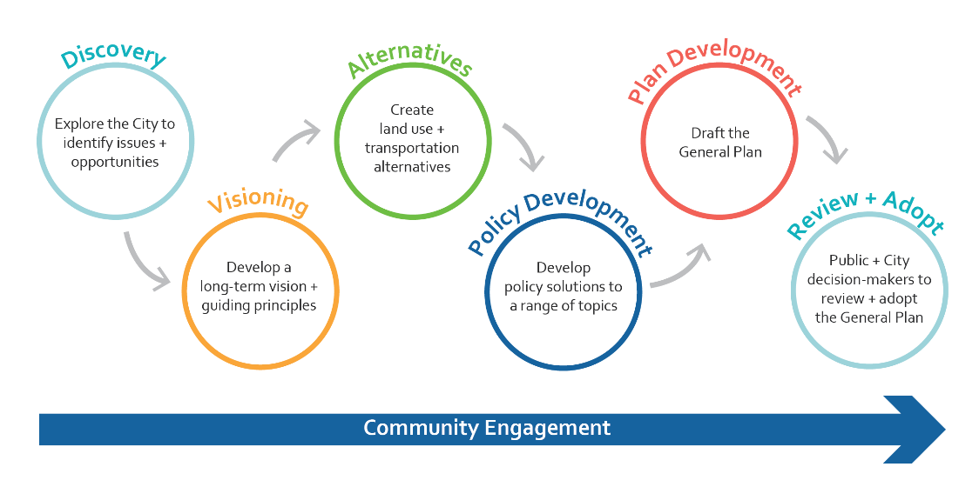
General Plan Update Process
Endorsed by City Council on March 28, 2022
5

Slide 7
Community Outreach to Date
General Plan website with videos, resources & events calendar
65+ GPAC meetings, workshops, stakeholder interviews, and other meetings
18 Community pop-up events
5 Surveys with 7,866 responses
Local news articles & advertisements with 100,000 print copies distributed
60 GPU videos
Direct mailers sent to 42,000 residents and 32,000 water bill customers
Over 200,000 people reached on social media (City & GPU)
E-blasts & newsletters shared with more than 89,000 subscribers
1,000+ Public Comments
6
Visit www.PlanVentura.com to register for emails, view documents, or events calendar

Slide 8
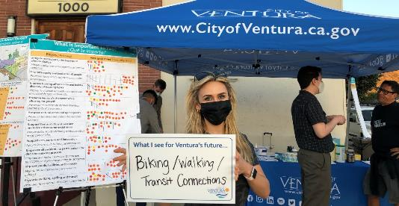
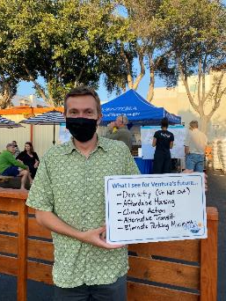
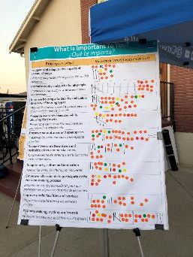
Engagement Efforts To Date
24 GPAC meetings
6 Educational forums
5 Community Workshops and Open Houses
21 Community Council meetings (3 rounds)
18 Pop-up events
23 Stakeholder interviews
5 City Council meetings
6 Board and Commission meetings
5 Community Surveys and Feedback Forms:
Issues & Opportunities (Nov 2020 – Jan 2021): 2,368 responses
Visioning (Aug - Oct 2021): 1,505 responses
Vision Statement Review (Mar 2022): 341 responses
Land Use Alternatives (Aug-Oct 2022): 2,471 responses
Preferred Land Use (June – Aug 2023): 1,181 responses
7

Slide 9
Vision Statement

Slide 10
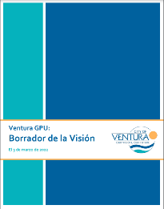
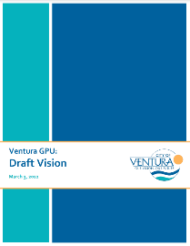
Implement the Vision
Describes what the future of the City will look like
Developed through extensive community engagement and multiple meetings with the GPAC.
Endorsed by the City Council on March 28, 2022.
Serves as the basis for the land use alternatives and topic-specific goals and policies.
Includes three components:
Vision Statement: describes where the City aspires to be in 2050
Core Values: define Ventura’s culture and priorities
Strategies: provide specific benchmarks or actions for achieving the vision/core values
“The residents of Ventura will implement a shared vision to achieve a sustainable, equitable, and resilient future. We will work together to protect the characteristics we cherish the most: the California beach town character; the welcoming, close-knit community feel; views of and access to the ocean and hills; our rich history; the diversity of cultures, races, and ethnicities."

Slide 11
Implement the Vision – Land Use Strategies
Enhance neighborhoods with infill
Strengthen the Downtown
Transform commercial corridors
Expand the number and diversity of housing units
Develop around transit
Add retail, services and housing to East Ventura
Expand employment uses
Protect public open spaces
Reduce GHG emissions
Reduce air pollution
Avoid wildfire and SLR areas
Increase walking, biking and transit
Notes:
As I mentioned, the alternatives explore different ways to achieve the vision through land use decisions. The vision starts with a brief sentence that sets up the whole of the vision: “The residents of Ventura will implement a shared vision to achieve a sustainable, equitable, and resilient future.”
In order to create this future, the city must look at land use changes. This slide shows a list of specific strategies from the Vision and Guiding Principles that relate to land use. These include:
- [read from list]

Slide 12
Land Use Designations

Slide 13
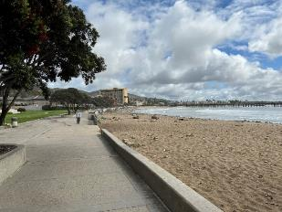
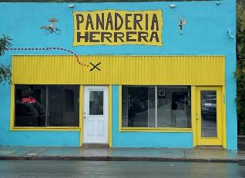
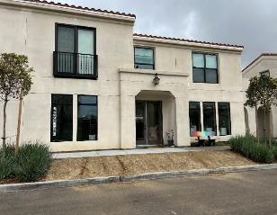
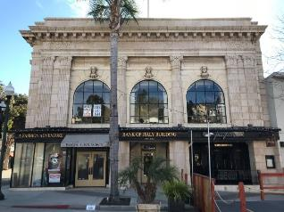
What are “Land Use Designations”?
Defines the future (allowable) type, distribution, and intensity of all parcels
Includes a land use diagram
Establishes standards for density
Residential (dwelling units per acre)
Non-residential (floor-area ratio)
Must align with and reflect content from other elements

Slide 14
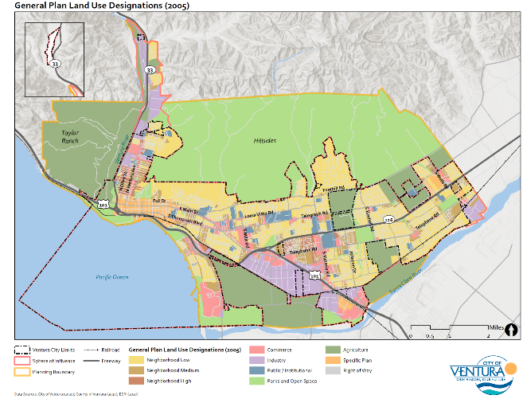
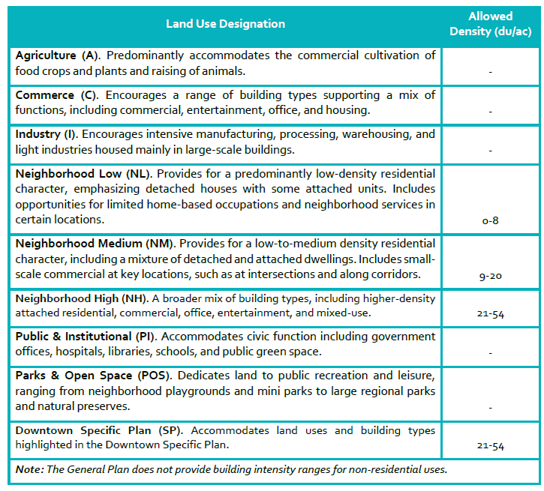
Existing General Plan Land Use Designations
Notes:
This is a map of Ventura
Let me point out a few landmarks
- 101
- 126
- Mall
- Downtown
- Harbor
GP Strategies:
• Pursue an “Infill First” strategy that directs growth to vacant and underutilized sites within the City Limits and SOI.
• Attract and retain enterprises that provide high-value, high wage jobs.
• Reinvest in older areas of the community.
• Provide and maintain facilities that enable the community to live in balance with natural systems.
• Expand the park and trail network to link shoreline, hillside, and watershed areas.
• Protect hillsides, farmlands, and open spaces.
• Enhance Ventura’s historic and cultural resources.

Slide 15
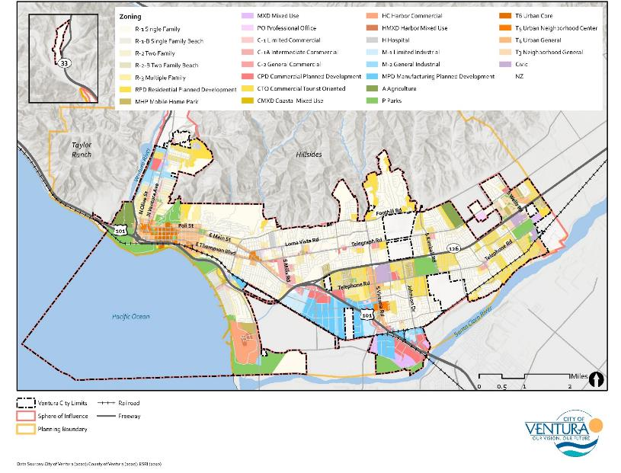
Existing Zoning
Implements policy direction through development standards and guidelines
Required by State law to be consistent with the General Plan
Typically contains these standards:
Uses: Detailed types of uses allowed
Intensity: Density (dwelling units per acre) or intensity (floor area ratio); Building height and bulk
Site standards: Setbacks, Required open space, Parking, Transitions
Ventura has almost 50 zoning districts

Slide 16
Why do we need to Create New Land Use Designations?
Ventura's existing land use regulations (General Plan and Zoning) are not consistent with State law and legal precedent.
New land use designation map is needed to implement the new General Plan Vision statement and community feedback gathered through public engagement process.
New designations will provide more clarity and transparency on development decisions.

Slide 17
Overview of Revised Designations
31 designations in 5 categories
Based on zoning districts, with similar districts combined
Preserves residential zoning districts
Includes specific designations for coastal zone
Includes new designations for:
Commercial (no residential allowed)
Neighborhood Center
Office/R&D
Additional Industrial designations (3-story General Industrial and 6-story Light Industrial)

Slide 18
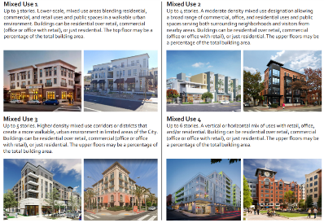
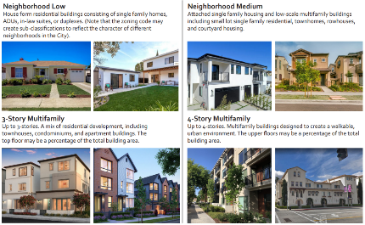
Proposed Land Use Designation Categories
Residential designations for the residential-only areas of the city.
Mixed-use designations to allow for a mix of uses in an area, including vertical and horizontal mixed-use within a single project.
Commercial designations to provide areas for retail, offices, and service uses. Residential uses are not allowed in these designations (except for Neighborhood Commercial where residential is allowed as a secondary use).
Employment designations to allow for a range of job-producing uses including light industrial, light manufacturing, research & development (R&D), and office uses. Residential uses are not allowed in these designations.
Public/Institutional uses including schools, parks, open spaces, hospitals, and other public uses.

Slide 19
Land Use Designation Methodology
Based in existing zoning districts
Residential zoning – generally a 1 to 1 between zoning and new designations
Commercial Zones
C-1 - applied Mixed Use 1 (3 stories/45 feet)
C-1A and C-2 – applied Mixed Use 4 (6 stories)
Form-based Zones (Downtown, Midtown, Victoria Corridor)
Matched based on maximum height of top floor but zoning will maintain percentage of top floor
Added density based on existing residential densities and an analysis of approved projects
Industrial
Created 2 Light Industrial/Flex Designations – 3 story and 6 story (based on M1 zoning)
Created 2 General Industrial Designations – 3 story and 6 story (based on M2 zoning)
Coastal zones – C0astal-specific land uses designations created
New designations
"Commercial"-only designation that does not allow residential
"Neighborhood Center"
Detailed public and institutional designations to reflect current conditions
Notes:
This slide has some very technical information about specific zoning districts and land use designations.
If you are not familiar with the city's existing zoning and general plan or are not a planner, this is likely to be very confusing.
Don’t worry about this detail for now. You can come to the office hours and other meetings to ask questions and we'd be happy to explain it to you.

Slide 20
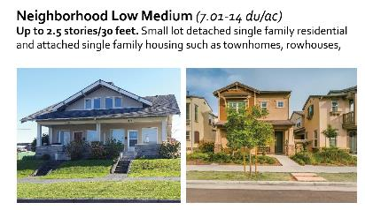
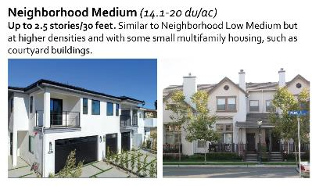
Residential Designations
Note: heights and densities exclude State mandated density bonus law

Slide 21
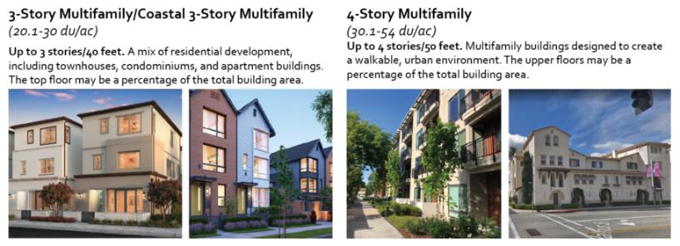
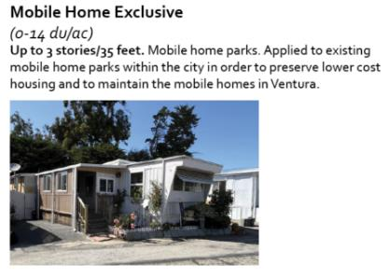
Residential Designations
Note: heights and densities exclude State mandated density bonus law

Slide 22
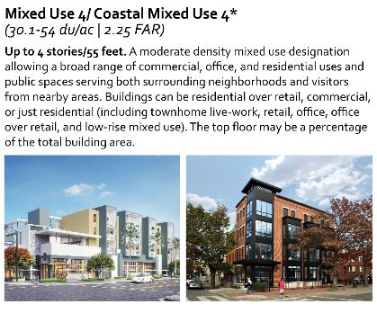
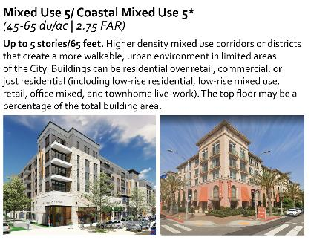
Mixed Use Designations
Note: heights and densities exclude State mandated density bonus law

Slide 23
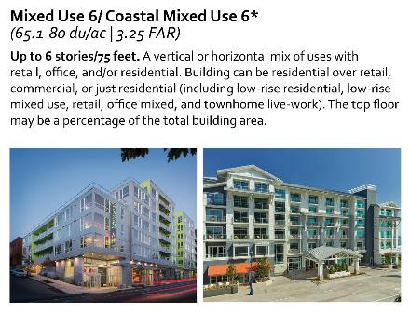
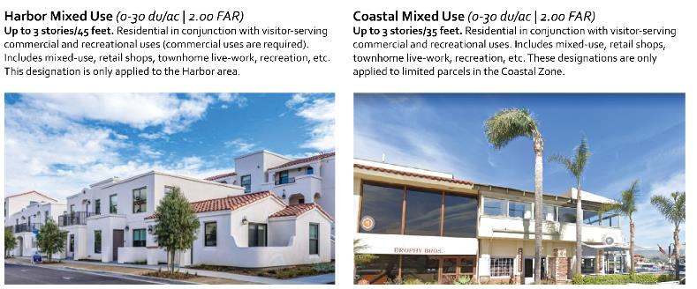
Mixed Use Designations
*Note that the Coastal Mixed Use 1, Coastal Mixed Use 2, Coastal Mixed Use 3, and Coastal Mixed Use 4 designations are for parcels in the coastal zone. The standards for the designations are identical to the Mixed Use 1, Mixed Use 2, Mixed Use 3, and Mixed Use 4 designations, respectively, unless otherwise noted.
Note: heights and densities exclude State mandated density bonus

Slide 24
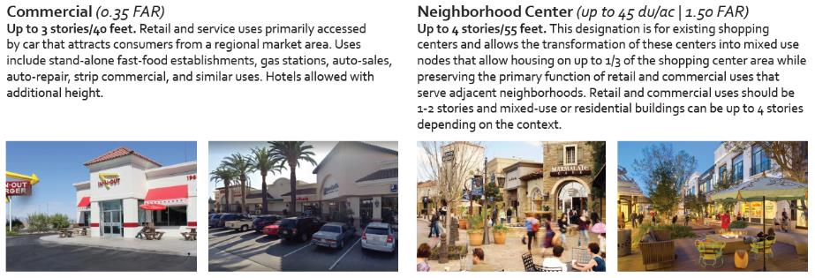
Non-Residential Designations

Slide 25
Non-Residential Designations

Slide 26
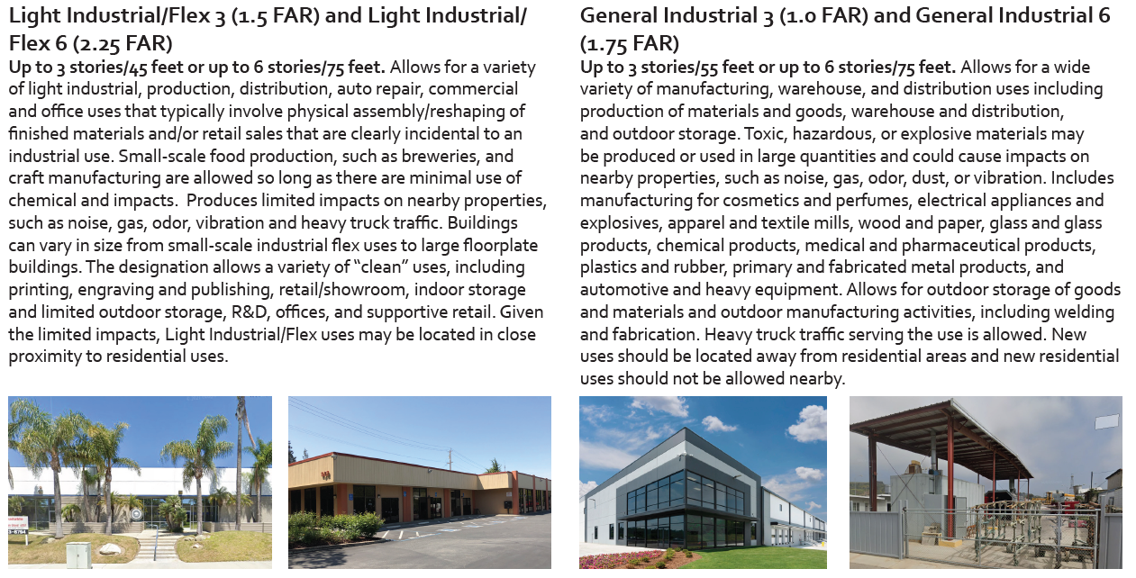
Industrial Designations

Slide 27
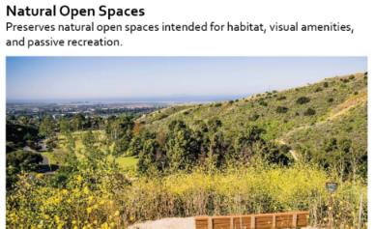
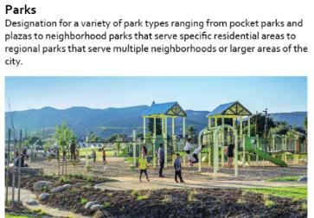
Public and Institutional

Slide 28
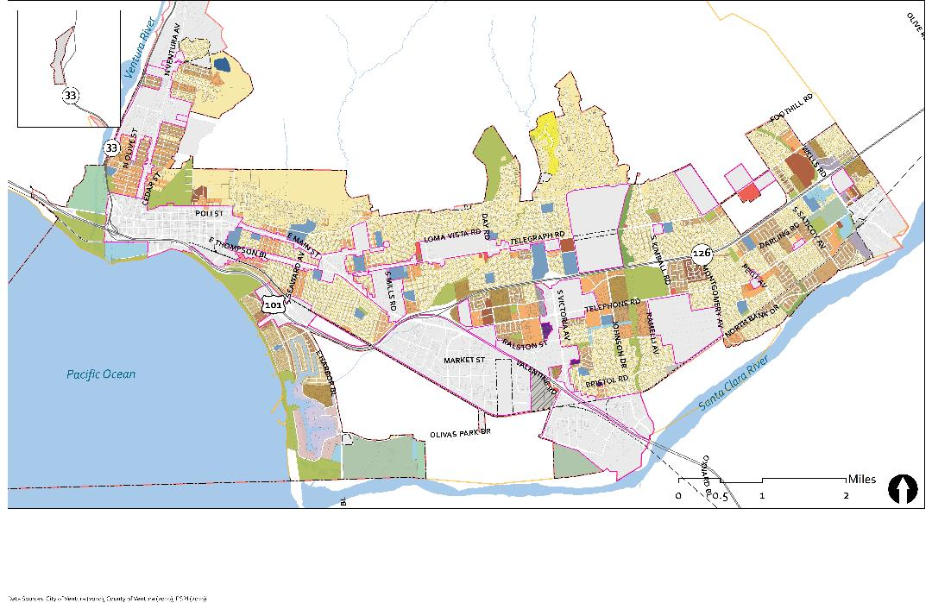
d
Draft “Base” Land Use Designation Map – Outside Areas of Discussion
Notes:
Multi-step process
- created a correspondence table between zoning and land use designations. This worked on many but not all instances
Examples
- Residential Planned Development = matched to what is built on the ground
- Some C-1, C-1A and C-2 zones near the freeway were changed to "commercial" to not allow residentail
- Applied some coastal designations to some residential areas that are in the coastal zone (at parallel densities)
- Applied schools to all schools, parks to all parks, etc.
The result is this map, which is used as the base for the alternatives.

Slide 29
Land Use Alternatives
Notes:
The phase of work that we are current in is to develop land use and growth alternatives. I’d like to give you an overview of some of the key assumptions behind this phase and a preview of the engagement that will be occurring over the coming months.

Slide 30
Path to a Preferred Land Use Map
GPAC finalized “Areas of Discussion” and reviewed Citywide Framework
(Nov/Dec 2021)
Develop and Review Land Use Alternatives
(Summer 2022)
Planning Commission (Aug 22 & 23, 2023*)
Visioning Survey: Where should development go? (Fall 2021)
Initial identification of Areas of Change + Stability (July 2021)
Engagement on Land Use Alts
(Aug – Oct, 2022)
10 GPAC Meetings – Review Alternatives
(Sept 2022 – June 2023)
GPAC generated ideas for alternatives (April and May 2022)
Engagement on Preferred Land Use (June – Aug 2023)
City Council
(Sept 11 & 25, 2023)
City Council Direction on Growth Targets
(July 2022)
GPAC Meetings
Public Engagement
Consultant Work
CC/PC Action
10
Notes:
This flow chart represents the process that we are using to develop, review and select land use alternatives.
The end goal is to have a proposed land use designation map.
The process started about a year ago when we discuss areas that the community felt could change, and areas that the community felt would stay the same over the time horizon of the General Plan.
We then used the Visioning Survey in the fall of 2021 to identify preferred uses by location.
Working with the GPAC, we finalized the areas of discuss.
Interspersed with this process was the development of the vision and guiding principles. The GPAC spent a long time on the Vision and Guiding principles, (not that its an issue but longer than other communities we have worked with in the past).
In the spring, the GPAC held 2 meetings to develop ideas for preferred land uses in the identified Areas of Discussion.
As you will see later the team is using all this information to develop the alternatives.
The alternatives will then be take to the public and the GPAC for inout and finally the PC and CC for direction.
More time on vision and alternatives than other communities
Highlight role of GPAC in the process – sounding board and bounce ideas off of them.

Slide 31
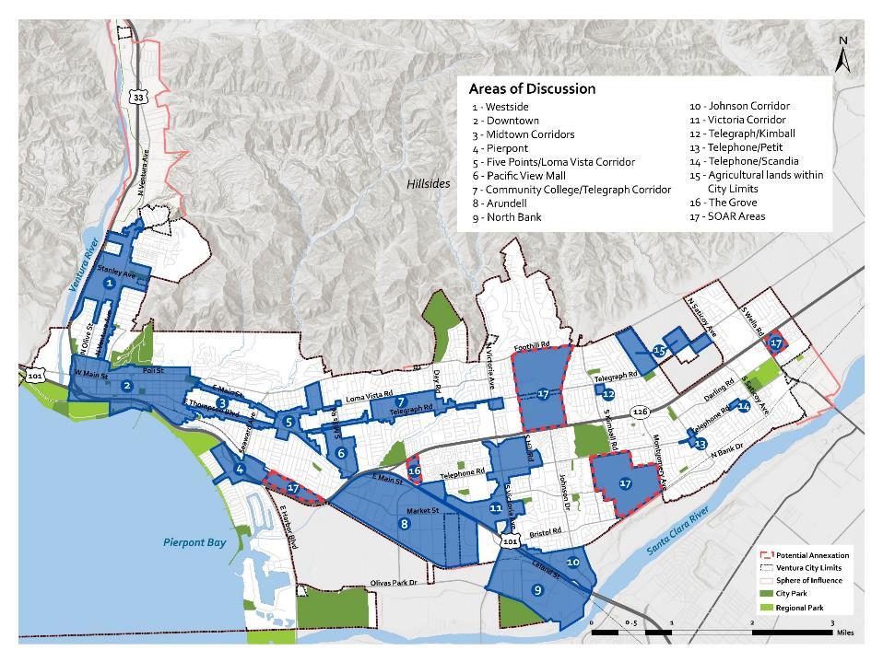
Areas of Discussion
Note: These areas were renumbered but the geographic areas remain the same
NOTE: This map was used during the process of developing the land use alternatives to identify specific geographic areas for discussion. It contains some factual inaccuracies regarding properties that are subject to the SOAR Ordinance. These inaccuracies have since been corrected in subsequent materials.
Notes:
Approximately 25% of City is in these areas of discussion but as you will see, far few parcels are proposed for new land use designations in each alternative.
Based on public feedback from the Visioning Survey, the GPAC identified and refined the “Areas of Discussion.” Discussions on this map occurred in July, October and November 2021 and January and February 2022). These are areas where land use designation changes and/or new, substantial development should be considered over the next 20-30 years. The map shows the final Areas of Discussion.
Areas outside of the Areas of Discussion will generally maintain their current land use designations. These areas are represented in white in the map to the right.
While there was general agreement that these are the locations where land use changes or new development should occur, there was not consensus on the types of uses or intensity of development in each area. Some residents expressed a strong desire for limiting growth to fewer areas while other expressed a desire for more higher density development throughout the city. The purpose of the land use alternatives is to explore different ideas about where development could occur and develop a direction based on the feedback received through the process.

Slide 32
Housing Laws
General Plan must follow all State laws
No net loss of residential capacity. This prohibits rezoning from residential to commercial and reducing intensity of residential without concurrent increases elsewhere (SB 330)
No growth moratorium, voter approval of general plan changes and other restrictions on housing (SB 330)
If the density under the zoning ordinance is inconsistent with the density under the general plan or specific plan, the greater shall prevail (AB 2334)
Must follow State density bonus law without reduction in density or height.
Land use designations DO NOT include State mandated density bonuses

Slide 33
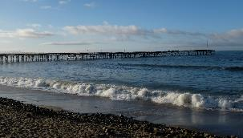
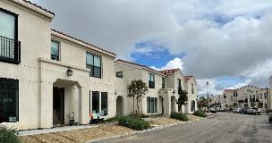
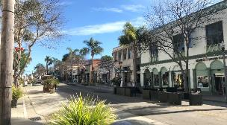
Proposed Capacity for Updated General Plan
Horizon year – 2050 (27 years)
Capacity for alternatives; alternatives may not achieve this
Residential
Plan for approximately 2 - 3 RHNA cycles or 10,600 – 15,900 units
About 1% growth per year
Non-Residential
Amount dependent on residential growth
1.39 jobs/housing unit (average)
Total job increase of between 14,700 and 22,000 jobs (6m to 9m sf)
Unanimously endorsed by the City Council on July 11, 2022
Notes:
This slide represents our working assumption on the range of growth for the updated General Plan (through approximately 2050).
Because much of planning now is driven by the need for new housing, we are assuming an amount of development of 2-3 times the current RHNA (regional housing needs allocation). The current RHNA is 5300 units so we are assuming development of between 10,600 and 15,900 units.
Non-residential development is directly dependent o the amount of residential development. The current ratio of jobs to housing units is 1.39 jobs for every housing unit. Thus the total number of jobs is between 14,700 and 22,000 (or around 6 million to 9 million square feet of employment uses).
The proposed development projections are important because the land use alternatives need to have sufficient carrying capacity (ie, land that could redevelop) to accommodate the development projections. This means we need to find land at sufficient densities to support in excess of the development projections.
Tonight, we are looking for confirmation from the City Council that this range of development projections for residential and non-residential development is acceptable.
Existing General Plan growth = 8,318 units

Slide 34
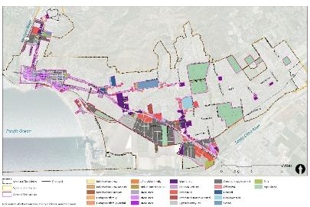
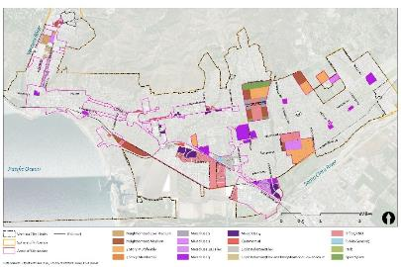
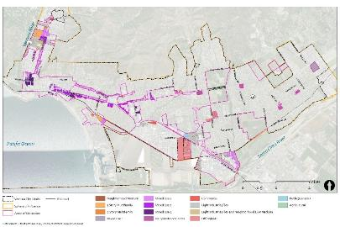
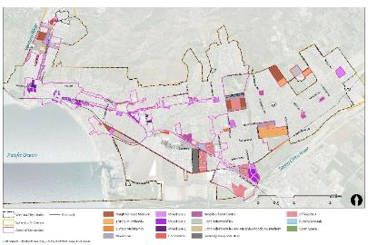
Land Use Alternatives
Base
Expansion
Discuss how the physical form of the City will evolve in 20-30 years
Implement the Vision and Strategies and growth targets endorsed by the City Council
Spark conversation about the future of the City.
The final land use map will likely be a combination of ideas from each survey plus new ideas generated during the process.
Core
Distributed
Notes:
As a reminder, this slide outlines the purpose of the land use alternatives.
The purpose is to ensure that there is sufficient capacity for growth and discuss how the physical form of the city will evolve over the next 20-30 years.
The underlying assumption is that cities are not static places. The evolve over time to reflect new market realities, changes in demographics, in and out migration, demographic shifts and other factors.
During the land use alternatives process, the goal is to test different land use and urban design patterns to understand how best to implement the vision of the community developed during the visioning process.
They are meant to spark a discussion among residents about the future of the city as there is clearly not one vision for the future among 110,000 residents.
Also, as we have said before, the final land use map will likely be a combination of ideas presented in the alternatives plus new ideas generated during the process.

Slide 35
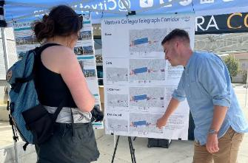
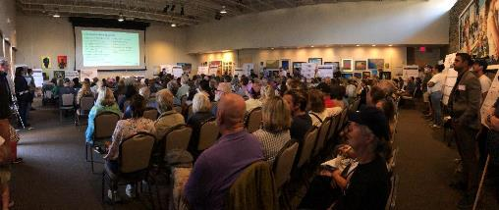
Engagement for Alternatives
Significant outreach
2 Workshops (300+ attendees)
Meetings with Community Councils and Downtown businesses and residents (8 meetings with 150+ participants)
11 pop-up workshops (350+ participants)
3 office hours
11 individual online surveys (2000+ responses)

Slide 36
10 GPAC Meetings
September 20, 2022 – Overview of Alts
October 18, 2022 – Water supply
November 17, 2022 – Survey results
January 17, 2023 – Alts review process
February 21, 2023 – Victoria, Pierpont, Eastside
March 6 and 7, 2023 – Eastside, College, Johnson, Westside
March 21, 2023 – Downtown
April 18, 2023 – Five Points/PCM, Arundell/North Bank, Midtown Corridors, SOAR Areas, Johnson
June 6, 2023 – Review of GPAC Feedback Form and finalize preferred land use

Slide 37
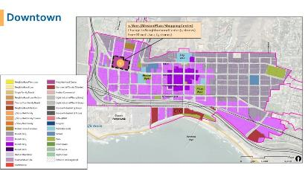
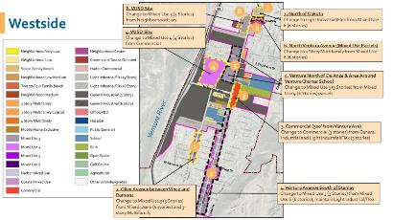
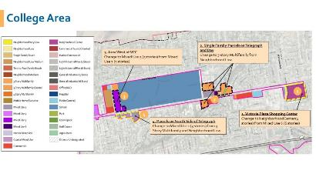
Result – GPAC Consensus Land Use Map
Limited land use changes; many areas remained the same
Most areas have more than 2/3 of GPAC members in agreement
No clear direction on dissenting ideas
Overall development capacity slightly higher than Base
Many policy ideas for land use and design
Made changes to land use designations to meet GPAC’s ideas/vision

Slide 38
Public Feedback Forms
Purpose: public feedback on the GPAC preferred land use map
Timing: Open from June 30 to Aug 2, 2023
High Level (807 responses)
For residents to provide feedback on the vision for different areas of the city as well as citywide policy direction
Detailed (374 responses)
For residents who want to provide detailed input on land uses at the parcel level

Slide 39
Areas of Discussion (GPAC Land Use Changes with results from Feedback Forms)

Slide 40
Proposed Land Use Designation Changes
Focused only on Areas of Discussion
Maps reflect proposed land use designations
Changes are described in call-out boxes
Box color represents level of public’s agreement with GPAC direction
Green = 60%-plus agreement between GPAC and public
Yellow = Majority agreement ( more “agree” than “disagree” by at least 10 percentage points or up to 60% of public agreeing with direction)
Red = Discrepancy between GPAC and public input
Planning Commission recommended direction annotated on maps in white box; land use designations were not changed on the maps

Slide 41
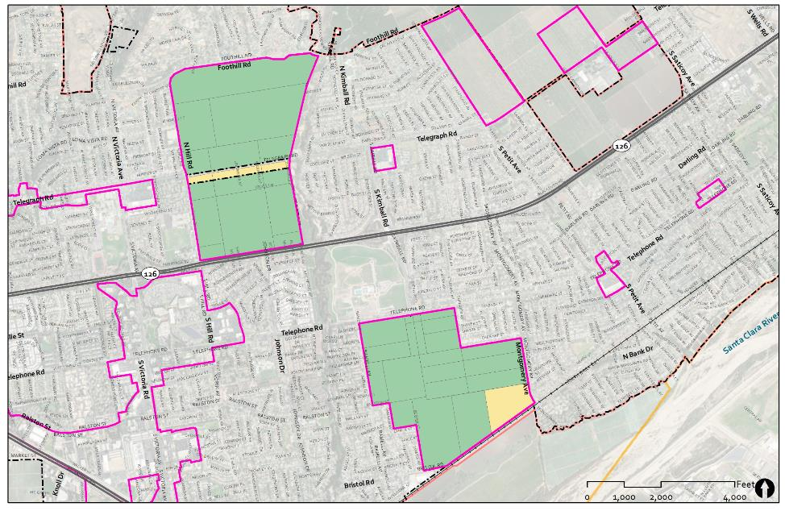
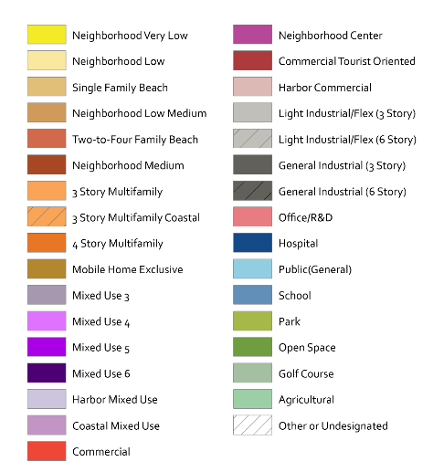
SOAR Areas
PC = Supported GPAC direction
* Note that these are not the only City-controlled SOAR areas in Ventura
No Changes
Neighborhood Low
This area is Neighborhood Low in existing General Plan. The map was changed to reflect the existing designation.

Slide 42
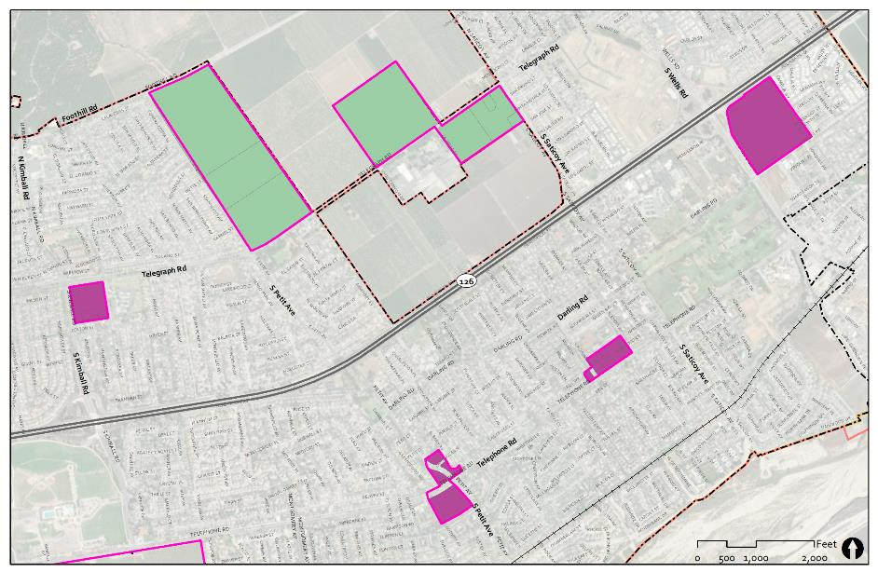
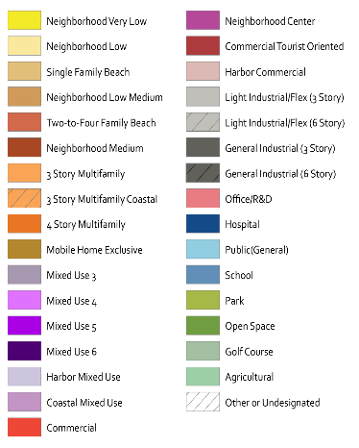
Eastside
PC = Supported GPAC direction
Agricultural Parcels
Note that these parcels are part of the City SOAR
2
1
2. Agricultural Parcel on SR-126/Wells
Change to Neighborhood Center (4 stories) from Mixed Use 3 (3 stories)
1. Shopping Centers
Change to Neighborhood Center (4 stories) from Mixed Use 6 (6 stories)
1
1

Slide 43
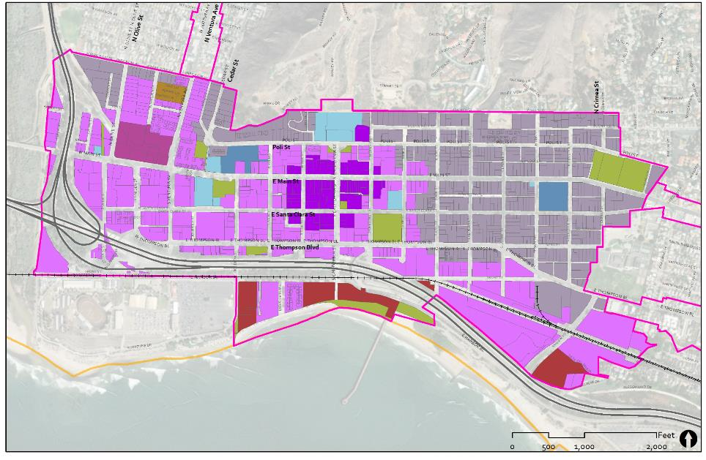
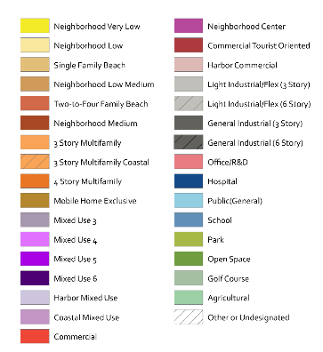
Downtown
PC = Supported GPAC direction
1. Vons (Mission Plaza Shopping Center)
Change to Neighborhood Center (4 stories) from Mixed Use 4 (4 stories)
City Hall
1
Mission Park
Plaza
Park
CTO
County Fairgrounds
Pacific Ocean
Ventura Pier

Slide 44
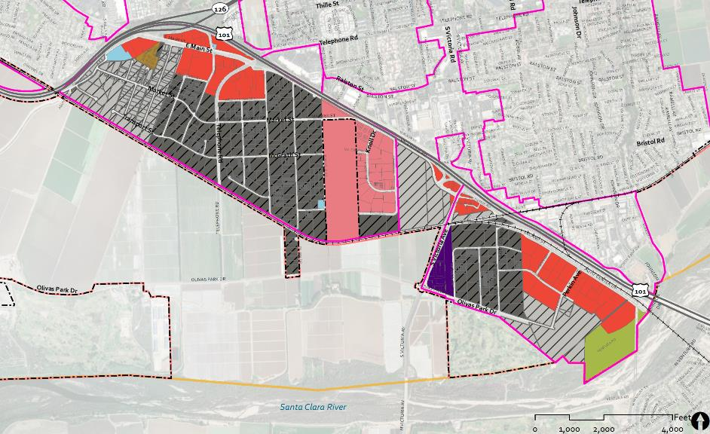
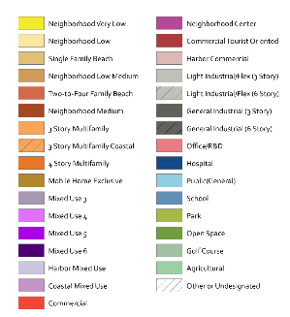
Arundell & North Bank
PC = Supported GPAC direction
1. Retail Shopping Centers
Change to Commercial (3 stories) from Mixed Use 6 (6 stories)
1
2. McGrath Property and Parcels to the East
Change to Office/R&D (6 stories) from Agriculture and General Industrial
Planning Commission recommended a Specific Plan for the McGrath property
2
Ivy Lawn Memorial Park
Height of Light Industrial/Flex increased to 6 stories/75 feet
Notes:
Key Takeaways
Maintain a retail and employment focus
Maintain agricultural uses on the McGrath property
Mixed feedback on the amount of Office/R&D and at what scale
Community opinion split on whether housing should be allowed
Areas Currently Allowing Housing
Mixed feedback on:
Prohibiting housing and eliminating current mixed-use zones
Allowing at least some residential (in limited areas or everywhere in Arundell/North Bank)

Slide 45
Victoria
PC = Supported GPAC direction
3. Parcels at Corner of Victoria and Telephone
Change to Mixed Use 6 (6 stories) from Office/R&D (6 stories)
Government Center
1
3
2
2. Parcels South of Government Center
Change to 4 Story Multifamily from Neighborhood Low
1. Parcels East of Government Center
Change to Mixed Use 4 (4 stories) from Commercial
5
5. Gateway Shopping Center
Change to Neighborhood Center (4 stories) from Commercial
4
4. Moon Drive Overlay Area
Change to Mixed Use 3 (3 stories) from Mixed Use 6 (6 stories
Notes:
Government Center
Responses lean toward keeping current zoning but approximately 40% support allowing some 4-5 story mixed use.
Comments from engagement supported adding some residential to the area, especially the Government Center parking lot.
Gateway Shopping Center
39% want to maintain as a regional shopping center
45% want either all mixed use or “neighborhood center” that maintains the center but allows residential.
Grove
46% said Maintain current zoning and specific plan
39% wanted more housing
“other” responses were mixed – some wanting more housing and some wanting less.

Slide 46
Pierpont
PC = Supported GPAC direction
City Owned Parcel
Changed from LI/Flex to Commercial to match adjacent parcel.
Former Fruit Packing Plant
Change to 4 Story Multifamily to reflect 2005 General Plan land use designation
Planning Commission recommended a Specific Plan for the area
1
County
Credit Union
Marina Village Shopping Center
1. Marina Village Shopping Center
Change to Neighborhood Center (4 stories) from Mixed Use 3 (3 stories)
Pierpont Bay

Slide 47
Westside
8. VUSD Site
Change to Mixed Use 3 (3 Stories) from Neighborhood Low
8
7
7. North of Dakota
Change to Light Industrial/Flex from Mixed Use 6 (6 stories)
4. VUSD Site
Change to Mixed Use 4 (4 Stories) from Commercial
6
6. North Ventura Avenue (Mixed Use Parcels)
Change to 3 Story Multifamily from Mixed Use 6 (6 stories)
4
5
5. Ventura North of De Anza & Area Around Ventura Charter School
Change to Mixed Use 3 (3 Stories) from Mixed Use 6 (6 Stories) parcels
3
3. Commercial (300’ from Ventura Ave)
Change to Commercial (3 stories) from General Industrial (6 stories) and Light Industrial/Flex (3 stories)
2
2. Olive Avenue between Vince and Ramona
Change to Mixed Use 3 (3 Stories) from Mixed Use 6 (6 stories) and 3-story Multifamily
1
1. Ventura Avenue South of Stanley
Change to Mixed Use 3 (3 Stories) from Mixed Use 6 (6 stories); maintain Light Industrial/Flex
PC = Supported GPAC direction

Slide 48
Westside – Additional PC Recommendation
Planning Commission recommended changing all General Industrial – 3 story (dark gray) to Light Industrial/Flex – 3 story (light gray)
(Note: changes are not outlined on the map)

Slide 49
Midtown Corridors – GPAC and Public
1. Main and Thompson E. of Jordan Avenue
Change to Mixed Use 4 (4 stories) from Mixed Use 3 (3 stories)
1
1
Seaward

Slide 50
Midtown Corridors – Planning Commission
“Triangle” Area on south side of Main
Change to Mixed Use 4 (4 stories) from Mixed Use 3 (3 stories)
Remaining Areas
Keep as Mixed Use 3 (3 stories)
South side of Thompson
Change to Mixed Use 4 (4 stories) from Mixed Use 3 (3 stories)

Slide 51
Five Points/ Pacific View Mall – GPAC and Public
4. Telegraph Corridor
Change to Mixed Use 4 (4 stories) from Mixed Use 3 (3 stories) and Commercial
1. Loma Vista (north side)
Change to “Commercial” (3 stories) from Mixed Use 3 (3 stories)
1
4
2
3
2. Main Street
Change to Mixed Use 4 (4 stories) from Mixed Use 3 (3 stories)
3. Pacific View Mall parcels
Change 2 parcels to Mixed Use 6 (6 stories) from Mixed Use 3 (3 stories) and Neighborhood Low

Slide 52
Five Points/ Pacific View Mall – Planning Commission
Parcels across from PVM and “large” parcels on eastern side of area
Support GPAC proposed change to Mixed Use 4 (4 stories) from Mixed Use 3 (3 stories)
1
Planning Commission supported GPAC’s recommendation on Areas 1, 2 and 3.
Planning Commission recommended a modification to Area 4.
2
3
Remaining Areas
Keep as Mixed Use 3 (3 stories) not Mixed Use 4 as proposed by GPAC

Slide 53
College Area – GPAC and Public
2. Single Family Parcels on Telegraph and Day Change to 3-story Multifamily from Neighborhood Low
3. Area West of VCC
Change to Mixed Use 5 (5 stories) from Mixed Use 3 (3 stories)
1
3
2
4
1. Victoria Plaza Shopping Center Change to Neighborhood Center (4 stories) from Mixed Use 6 (6 stories)
4. Parcels on South Side of Telegraph Change to Mixed Use 3 (3 stories) from 3 Story Multifamily and Neighborhood Low

Slide 54
College Area – Planning Commission
Planning Commission supported GPAC’s recommendation on Areas 1, 2 and 4.
Planning Commission recommended a modification to Area 3 (to Mixed Use 4)
3. Area West of VCC
Planning Commission voted to change this area to Mixed Use 4.
(Note: existing is Mixed Use 3; GPAC proposed Mixed Use 5)
1
3
2
4

Slide 55
College Area

Slide 56
Johnson – GPAC and Public
3
3. Commercial parcels East of 101
Change to Mixed Use 3 (3 stories) from Commercial
Johnson Drive
Change to Mixed Use 4 (4 stories) from Commercial
East Ventura
Metrolink Station
2
1
2. General Industrial parcels South of the Metrolink Station
Change to Mixed Use 4 (4 stories) from General Industrial
1
Notes:
Wide variety of ideas for the future of the Johnson Corridor area suggested (some of which are conflicting). Ideas included:
Transforming the area into a transit village/destination that supports housing at all income levels and a wide variety of office, light manufacturing, and visitor-serving retail while phasing out noxious industrial uses.
Redeveloping the industrial areas south of/adjacent to the Metrolink station as mixed use. Concentrating higher density housing around the Metrolink station.
Maintaining/expanding the area as a mixed-use and industrial job center. Redesignating some areas for office/R&D, with potential locations for corporate headquarter(s).
Concentrating employment and industrial uses closer to the freeway and residential/mixed use away from the freeway.
Making the entire corridor residential and moving industrial uses to the other side of the freeway.
Promoting office uses along Johnson Drive and moving residential away from Johnson, closer to the Metrolink station.
Focusing light industrial and warehouse uses along the railroad.
Not developing anything and making the area “open space”
Create a specific plan for the reinvention of this area that complements access to the Metrolink.
Ensure that employment and retail in this area serve local residents and also attract people from other parts of the county
Identify opportunities to add more parks and open space to the area (i.e., a greenbelt along Johnson).
Promote the Metrolink station as a connection point to Los Angeles and major sporting events such as the 2026 World Cup and 2028 Olympics.
Require ground floor commercial uses on mixed use developments to accommodate visitor and resident needs.
Consider annexing the SOAR area east of Johnson for development.
Provide more grocery stores in Montalvo.
Add more neighborhood-serving retail (i.e., grocery stores) to underutilized shopping centers like the Toys R Us site.
Explore redevelopment opportunities for key sites such as the Victory Outreach Ventura Church (formerly a movie theater), vacant parcels west of Motel 6, the underutilized parking lot on Capri Avenue, and underutilized shopping centers.
Desire for a wide diversity of uses. The highest-ranking ones are (with 50% of respondents selecting one of these are:
Mixed use residential and multifamily residential
Light/clean industrial
Commercial and retail
Add additional residential to this area
50% of respondents identified Johnson Drive as an area to add more residential development (Q11 in Citywide survey)

Slide 57
Johnson – Planning Commission
3
Non-residential parcels north of station
Change to Mixed Use 3 (3 stories)
East Ventura
Metrolink Station
Planning Commission supported GPAC’s recommendation on Areas 1 and 3.
Planning Commission recommended a modification to Area 2 and added a change north of the Metrolink Station
Planning Commission recommended a Specific Plan for the area
2
1
2. West side of Area 2
Change to Mixed Use 3 (3 stories)
2. East side of Area 2
Change to Light Industrial/Flex – 3 stories
1
Notes:
Wide variety of ideas for the future of the Johnson Corridor area suggested (some of which are conflicting). Ideas included:
Transforming the area into a transit village/destination that supports housing at all income levels and a wide variety of office, light manufacturing, and visitor-serving retail while phasing out noxious industrial uses.
Redeveloping the industrial areas south of/adjacent to the Metrolink station as mixed use. Concentrating higher density housing around the Metrolink station.
Maintaining/expanding the area as a mixed-use and industrial job center. Redesignating some areas for office/R&D, with potential locations for corporate headquarter(s).
Concentrating employment and industrial uses closer to the freeway and residential/mixed use away from the freeway.
Making the entire corridor residential and moving industrial uses to the other side of the freeway.
Promoting office uses along Johnson Drive and moving residential away from Johnson, closer to the Metrolink station.
Focusing light industrial and warehouse uses along the railroad.
Not developing anything and making the area “open space”
Create a specific plan for the reinvention of this area that complements access to the Metrolink.
Ensure that employment and retail in this area serve local residents and also attract people from other parts of the county
Identify opportunities to add more parks and open space to the area (i.e., a greenbelt along Johnson).
Promote the Metrolink station as a connection point to Los Angeles and major sporting events such as the 2026 World Cup and 2028 Olympics.
Require ground floor commercial uses on mixed use developments to accommodate visitor and resident needs.
Consider annexing the SOAR area east of Johnson for development.
Provide more grocery stores in Montalvo.
Add more neighborhood-serving retail (i.e., grocery stores) to underutilized shopping centers like the Toys R Us site.
Explore redevelopment opportunities for key sites such as the Victory Outreach Ventura Church (formerly a movie theater), vacant parcels west of Motel 6, the underutilized parking lot on Capri Avenue, and underutilized shopping centers.
Desire for a wide diversity of uses. The highest-ranking ones are (with 50% of respondents selecting one of these are:
Mixed use residential and multifamily residential
Light/clean industrial
Commercial and retail
Add additional residential to this area
50% of respondents identified Johnson Drive as an area to add more residential development (Q11 in Citywide survey)

Slide 58
Citywide Policy Questions - GPAC and Public
Question 14. Require new development to “taper down” building heights (i.e., reduce building heights) when the project is immediately adjacent to single family homes.
90.30% of respondents agreed with this proposed policy.
Question 15. Improve design quality of new multifamily and mixed use buildings to create more pedestrian-oriented buildings that are reflective of Ventura’s character and identity. This includes landscaping, appropriate ground-floor setbacks, and architectural style and details that enhance the City’s visual appearance.
93.51% of respondents agreed with this proposed policy.
Question 16. Support the regional agricultural economy by promoting farmworker housing, allowing packing and processing facilities in employment and agricultural areas, and working with the County to implement policies to balance the preservation of agriculture with potential health impacts in adjacent residential areas.
83.02% of respondents agreed with this proposed policy.
Question 17. Take steps to expand the number and diversity of employment uses throughout Ventura to enhance the job-housing balance.
66.75% of respondents agreed with this proposed policy.
Question 18. Preserve historic buildings and promote “adaptive reuse” of buildings(i.e., renovating the buildings to allow different uses).
90.40% of respondents agreed with this proposed policy.
Question 19. Conduct a study on the Westside to identify if the area has a disproportionate pollution burden and, if so, the sources of the pollution.
76.21% of respondents agreed with this proposed policy.

Slide 59
Other Areas
Citywide
Maintain “Base” designations
Minor changes will occur for consistency and to address potential mistakes and align existing land uses
Harbor
Port Commission recommended changes to parcels and draft land use designation
County Areas
North Avenue – maintain parallel designations to County
Saticoy – maintain parallel designations to County

Slide 60
Conclusions/Results

Slide 61
6-story Buildings – Base

Slide 62
6-story Buildings – GPAC Proposed

Slide 63
Change in 6 Story Building Heights

Slide 64
Change in Building Heights Proposed by GPAC

Slide 65
Land Use Designation Changes Proposed by GPAC
(Note: The areas outlined in yellow represent changes proposed by the Planning Commission)

Slide 66
Density Changes from Base Proposed by GPAC

Slide 67
Facts about GPAC Preferred Land Use Map
Total Area
27% of the City and SOI are in the Areas of Discussion
6 Story Buildings (Areas of Discussion only)
8% of City/SOI area in Base
7% of City/SOI area in GPAC Preferred
Decrease of 85 acres (1% of City/SOI area)
Residential Capacity Change in Areas of Discussion (GPAC Preferred)
229 acres proposed for increase (1.7% of total City/SOI area)
121 acres proposed for decrease (0.9% of City/SOI area)
Increase of 1,800 units of total MAXIMUM capacity citywide (1% increase)

Slide 68
Growth Terms

Slide 69
Key Terms
4 separate concepts related to growth are included in the update process.
RHNA Site Selection
No Net Loss
Growth Projections for the EIR
City Council Growth Target
Each has a different purpose and methodology

Slide 70
RHNA Site Selection
Required as part of the Housing Element process
Jurisdictions required to identify sufficient capacity to accommodate SCAG's RHNA numbers
State requires that sites meet stringent criteria:
Parcel size
Expressed interest from developers
Uses 80% of max density or track record of building at assumed density
HCD reviews the methodology and the individual sites
RHNA site selection is complete

Slide 71
No Net Loss (Maximum Capacity)
Jurisdictions required to maintain the overall maximum residential development capacity
Maximum capacity is calculated by multiplying the total acres for each land use designation by the maximum density
Calculating baseline is challenging in Ventura for a number of reasons
This is the KEY calculation/metric for the General Plan, including the land use changes proposed by the GPAC and Planning Commission
Notes:
Land use designations are dictated by the 1985 General Plan for inside the Coastal Zone and the 2005 GP for the rest of the city.
The General Plan does not include densities for the Commerce designation
The City has multiple form-based codes that do not have densities
Several "Commercial" districts in the zoning code allow residential but do not have a density maximums.
There are inconsistencies between the land use designations and zoning districts

Slide 72
Growth Projections
Identify a realistic amount of growth over a certain period of time
Used to analyze potential environmental impacts for the EIR and for future infrastructure planning (transportation; water availability; schools; wastewater; etc.)
Growth projections are not...
A statement of policy
A growth management tool
Required to be included in the General Plan
A calculation of maximum capacity
Growth projections will be completed after the land use map is finalized

Slide 73
City Council Growth Target for Alternatives
City Council endorsed growth target on July 11, 2022
Residential: approximately 2 - 3 RHNA cycles or 10,600 – 15,900 units
Non-Residential: Maintain current jobs/housing ratio or between 14,700 and 22,000 jobs
Target was only used to help prepare alternatives
Achieving these numbers would require an increase in capacity
This is NOT related to citywide "no net loss" analysis or GPAC/PC land use map
Notes:
This slide represents our working assumption on the range of growth for the updated General Plan (through approximately 2050).
Because much of planning now is driven by the need for new housing, we are assuming an amount of development of 2-3 times the current RHNA (regional housing needs allocation). The current RHNA is 5300 units so we are assuming development of between 10,600 and 15,900 units.
Non-residential development is directly dependent o the amount of residential development. The current ratio of jobs to housing units is 1.39 jobs for every housing unit. Thus the total number of jobs is between 14,700 and 22,000 (or around 6 million to 9 million square feet of employment uses).
The proposed development projections are important because the land use alternatives need to have sufficient carrying capacity (ie, land that could redevelop) to accommodate the development projections. This means we need to find land at sufficient densities to support in excess of the development projections.
Tonight, we are looking for confirmation from the City Council that this range of development projections for residential and non-residential development is acceptable.
Existing General Plan growth = 8,318 units

Slide 74
GPAC and Planning Commission Land Use Analysis
Used maximum capacity (or "no net loss") methodology
Compared "Base" land use designations to land use designations proposed by GPAC then Planning Commission for the Areas of Discussion only
GPAC and PC land use map:
Minimal overall change in land use capacity
Increases in some areas were offset by decreases in other areas
Proposed land use changes would not meet the City Council growth target
City may need to change zoning in next RHNA cycle

Slide 75
City Council Direction

Slide 76
Westside – City Council
8. VUSD Site
Change to Mixed Use 3 (3 Stories) from Neighborhood Low
8
7
7. North of Dakota
Change to Light Industrial/Flex from Mixed Use 6 (6 stories)
4. VUSD Site
Change to Mixed Use 4 (4 Stories) from Commercial
6
6. North Ventura Avenue (Mixed Use Parcels)
Change to 3 Story Multifamily from Mixed Use 6 (6 stories)
4
5
5. Ventura North of De Anza & Area Around Ventura Charter School
Change to Mixed Use 3 (3 Stories) from Mixed Use 6 (6 Stories) parcels
3
3. Maintain Base Uses
Reject change to Commercial (3 stories); maintain General Industrial (6 stories) and Light Industrial/Flex (3 stories)
2
2. Olive Avenue between Vince and Ramona
Change to Mixed Use 3 (3 Stories) from Mixed Use 6 (6 stories) and 3-story Multifamily
1
1. Ventura Avenue South of Stanley
Change to Mixed Use 3 (3 Stories) from Mixed Use 6 (6 stories); maintain Light Industrial/Flex
Maintain General Industrial

Slide 77
Five Points/ Pacific View Mall – City Council
Parcels across from PVM and “large” parcels on eastern side of area
Support GPAC proposed change to Mixed Use 4 (4 stories) from Mixed Use 3 (3 stories)
1
City Council supported Planning Commission recommendation
2
3
Remaining Areas
Keep as Mixed Use 3 (3 stories) not Mixed Use 4 as proposed by GPAC
Notes:
Reduction in units compared to Planning Commission

Slide 78
Midtown Corridors – City Council
1. Main and Thompson E. of Jordan Avenue
Maintain Mixed Use 3 for entire corridor; reject GPAC and PC proposed changes
1
1
Seaward

Slide 79
Next Steps

Slide 80
Project Schedule to Draft General Plan
Growth projections (Late Fall 2023)
Policy direction (Fall 2023 and Winter 2024)
Initiate Local Coastal Program (Fall 2023)
Initiate EIR (Fall 2023)
Public Draft General Plan (Spring 2024)
Public Draft EIR (Spring 2024)
Adoption Hearings (Fall 2024)
Note: Dates in RED reflect a change due to extra CC meetings for land use

Slide 81
Public Engagement to Draft General Plan
7 GPAC Meetings (Open Space, Safety, Transportation, Policy, Draft EIR and General Plan)
4 Public Hearings (Parks and Recs, Arts and Culture, Historic Preservation, Planning Commission)
1 Open House/Workshop
Online Surveys
4 Adoption Hearings (2 Planning Commission, 2 City Council)
Note: This is all the public engagement that has been scoped and budgeted for the remainder of the General Plan Update

Slide 82
Thank You!

